Slide 1
Comic Books: pen & ink

Slide 2
1.
Comics 101
What is a comic book?

Slide 3
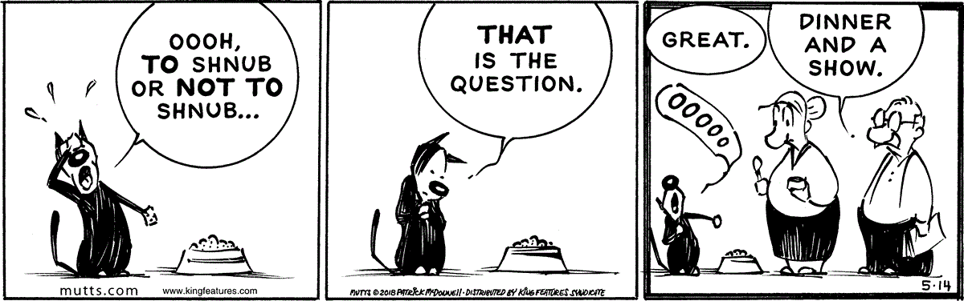
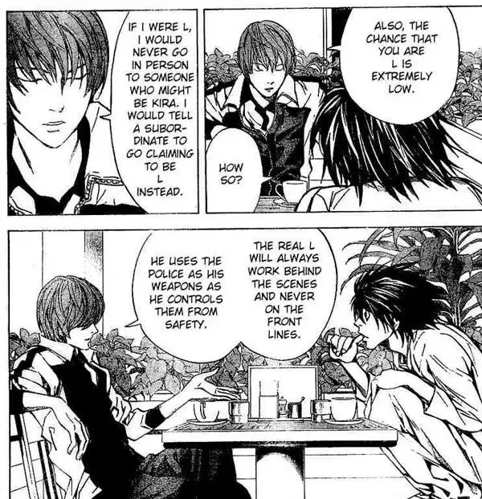
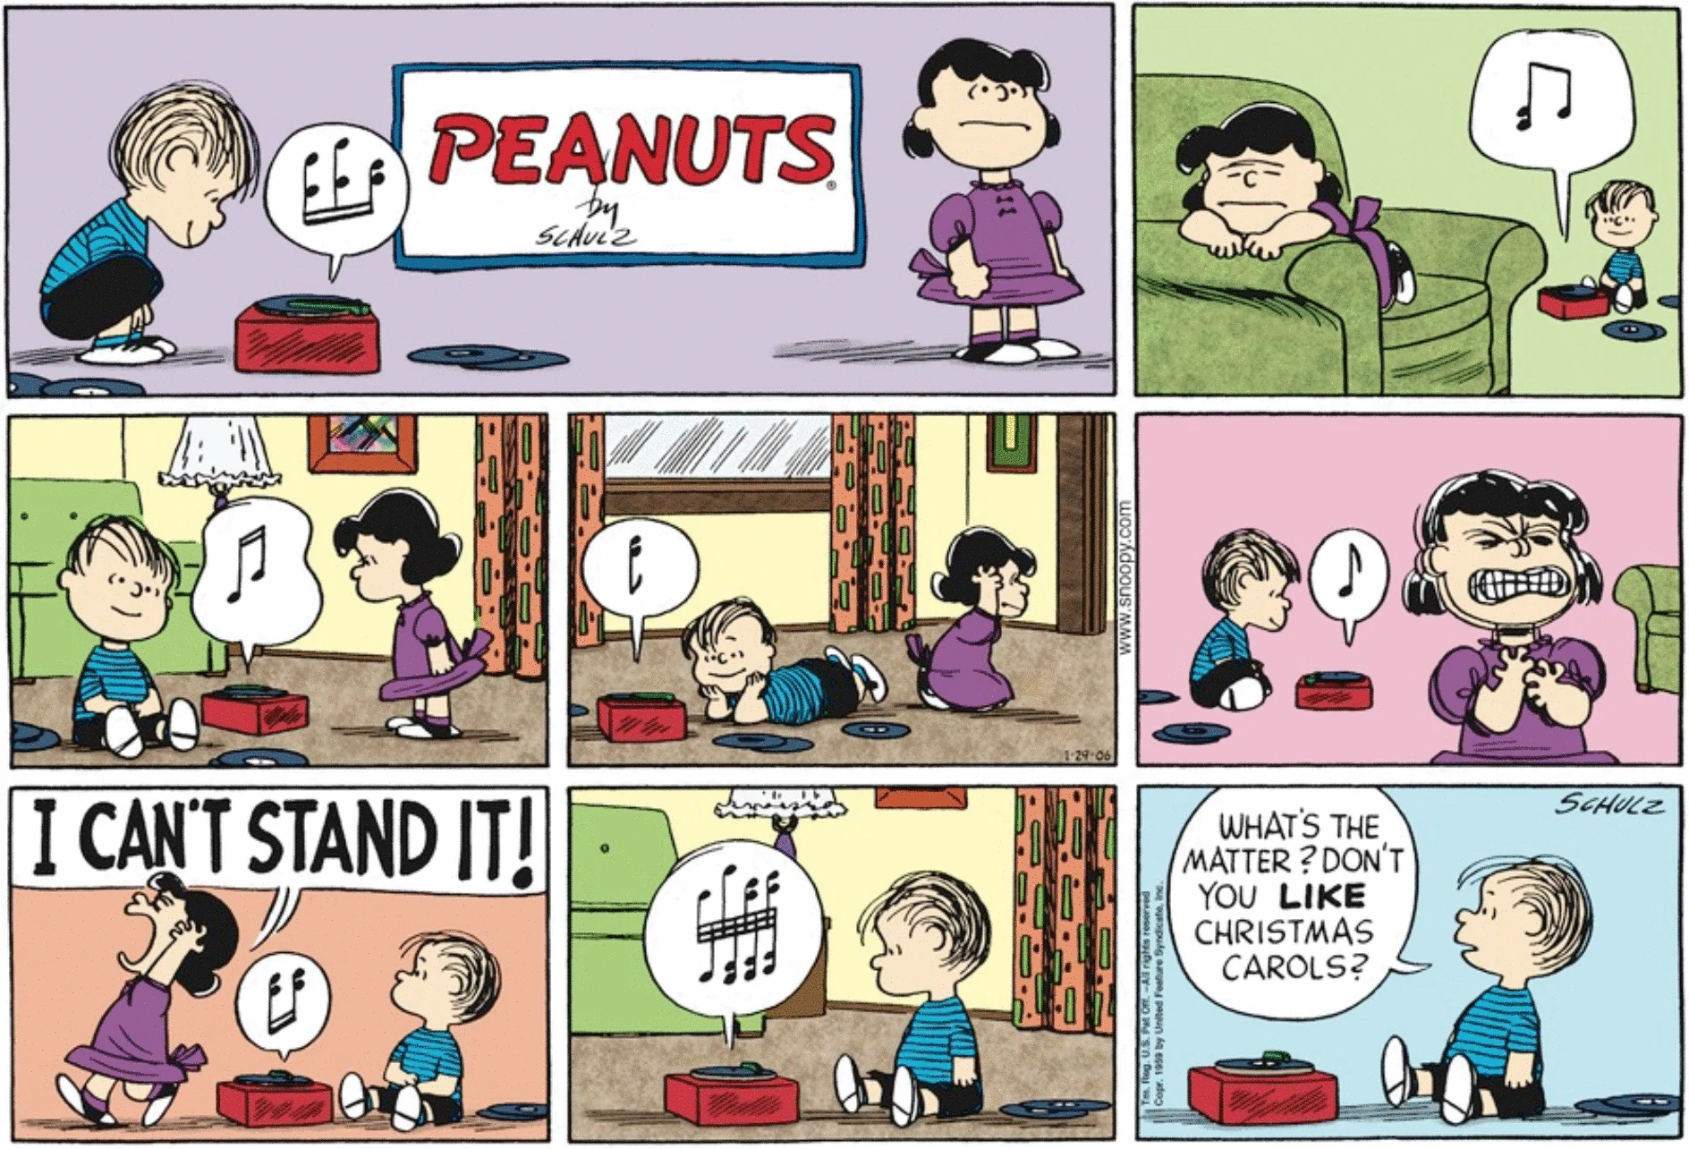
What is a comic? Comic book?
Notes:
Comics is a medium used to express ideas through images, often combined with text or other visual information. Frequently, comics takes the form of sequences of panels of images. Often textual devices such as speech balloons, captions, and onomatopoeia indicate dialogue, narration, sound effects, or other information.

Slide 4
What is a comic? Comic book?
Comics is a medium used to express ideas through images, often combined with text or other visual information. Frequently, comics takes the form of sequences of panels of images. Often textual devices such as speech balloons, captions, and onomatopoeia indicate dialogue, narration, sound effects, or other information.
Notes:
Comics is a medium used to express ideas through images, often combined with text or other visual information. Frequently, comics takes the form of sequences of panels of images. Often textual devices such as speech balloons, captions, and onomatopoeia indicate dialogue, narration, sound effects, or other information.

Slide 5
What is a comic? Comic book?
Fantasy vs. Reality
Overarching story or meaning
  Life lesson (friendship, respect, bravory, etc)
  Everyday life experiences
Notes:
Comics is a medium used to express ideas through images, often combined with text or other visual information. Frequently, comics takes the form of sequences of panels of images. Often textual devices such as speech balloons, captions, and onomatopoeia indicate dialogue, narration, sound effects, or other information.

Slide 6
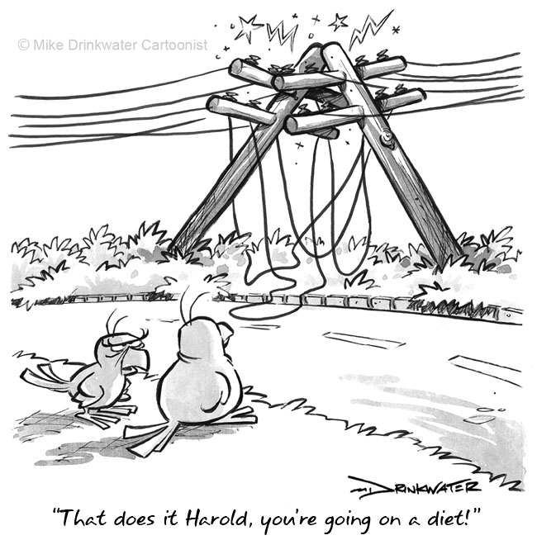
Types of comics
Comic Strips
Editorial and Gag Cartoons
Comic Books
Graphic Novels
Comic Albums
Zine (“zine”)

Slide 7
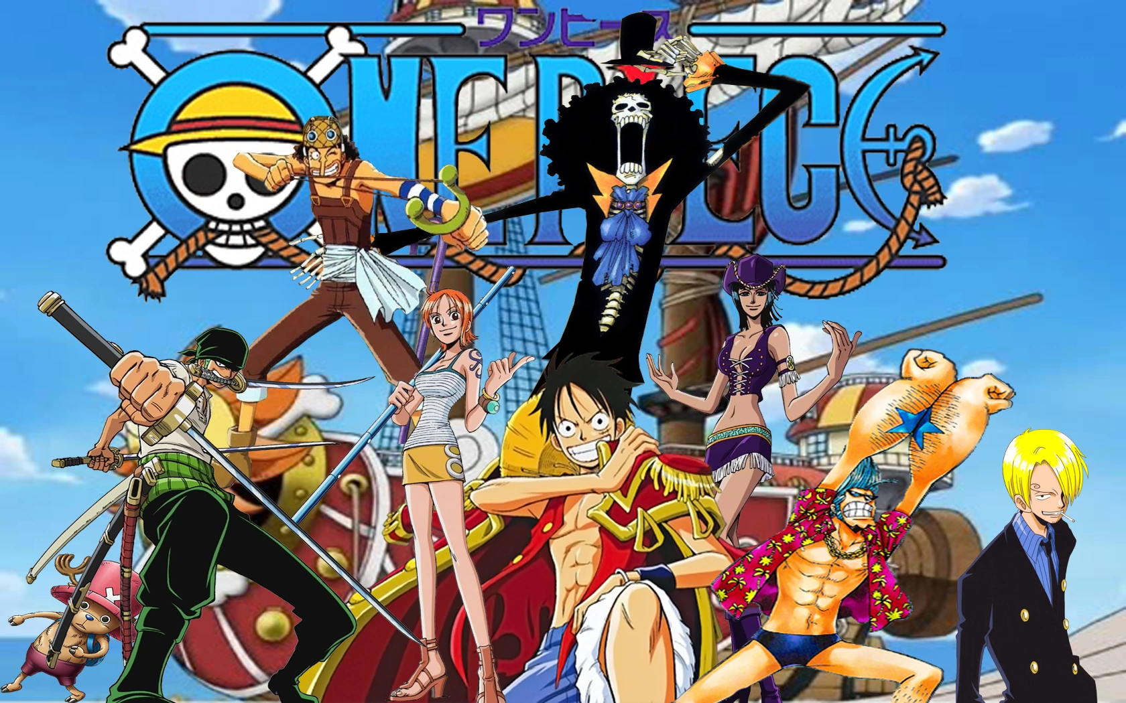
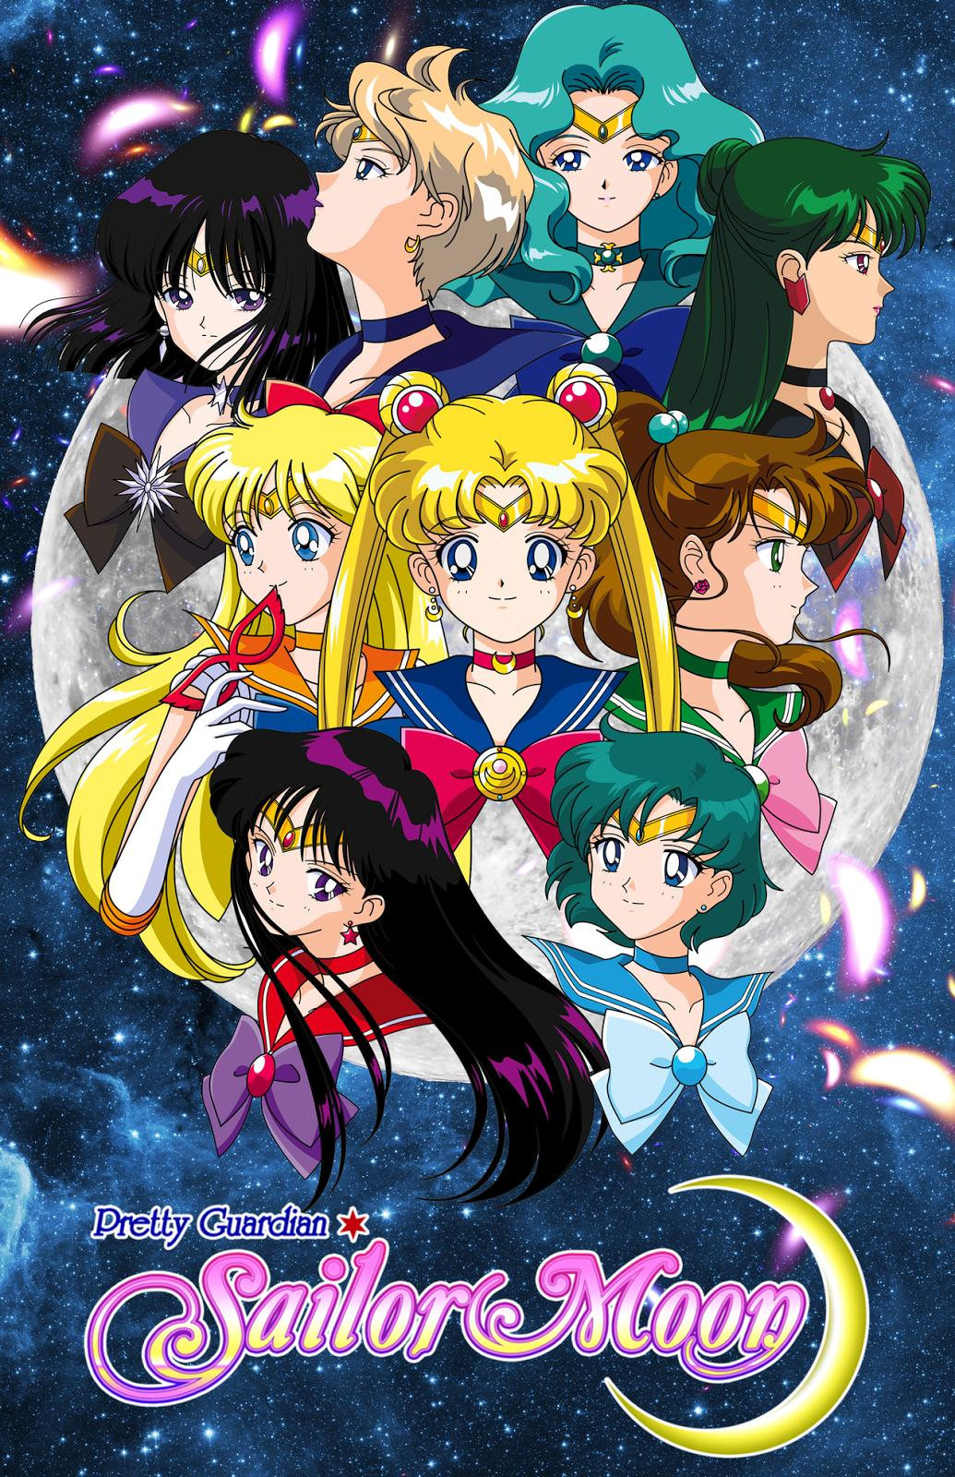
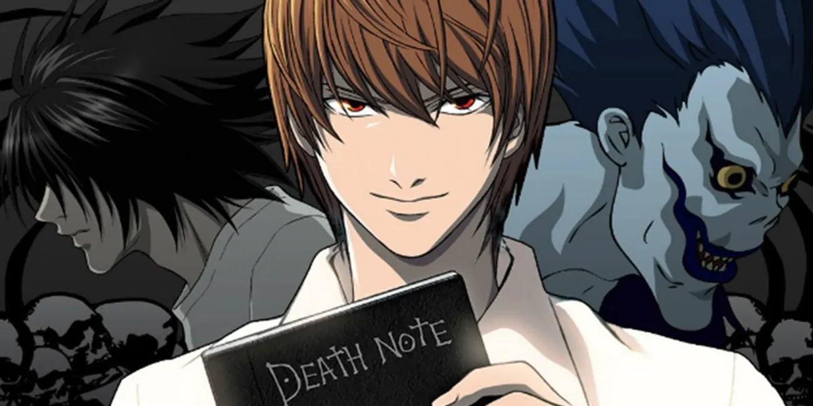
Types of comics: Japanese
Manga
  Tankōbon (Japanese series/volume)
Notes:
Manga is the term used for a style of japanese comics and cartoons, developed in the late 19th century. Manga became more popular in the 1950’s. Difference between anime and manga, anime is a TV show/movie, manga is a comic/cartoon.

Slide 8
History Of Comics: Manga
Manga traced back to the 12-13th century
Scrolls divided into panels, characters with written text and sound effects
Chōjū-jinbutsu-giga
Notes:
Manga is the term used for a style of japanese comics and cartoons, developed in the late 19th century. Manga became more popular in the 1950’s. Difference between anime and manga, anime is a TV show/movie, manga is a comic/cartoon. Chōjū-jinbutsu-giga (“Animal-person Caricatures”) is a set of 4 pictorial scrolls. They are meant to be read from right to left, as with most traditional asian scrolls.

Slide 9
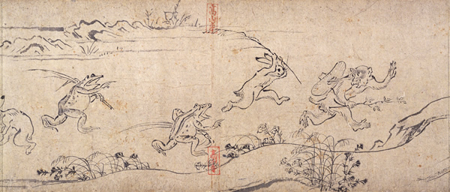
Chōjū-jinbutsu-giga
Panel from the First Scroll
12th-13th cent.
Notes:
Panels are not explicitly seen. Seens are divided by the repeating characters, as in traditional scrolls (cross-cultural).

Slide 10
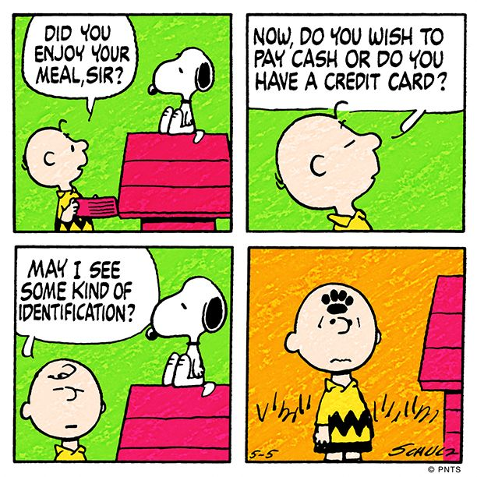
Image styles
Cartoon
Illustration
Fumetti

Slide 11
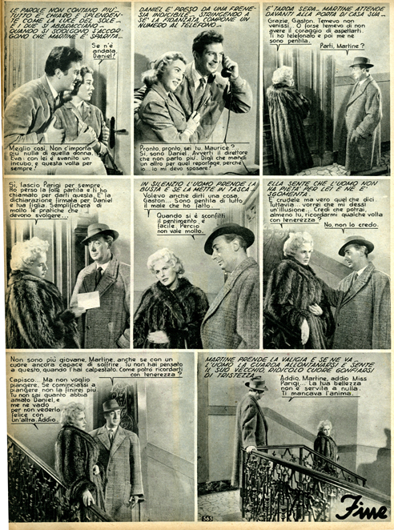
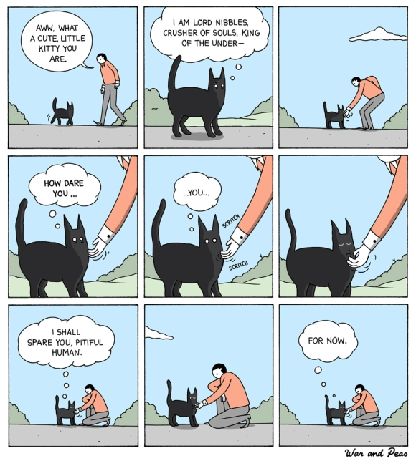
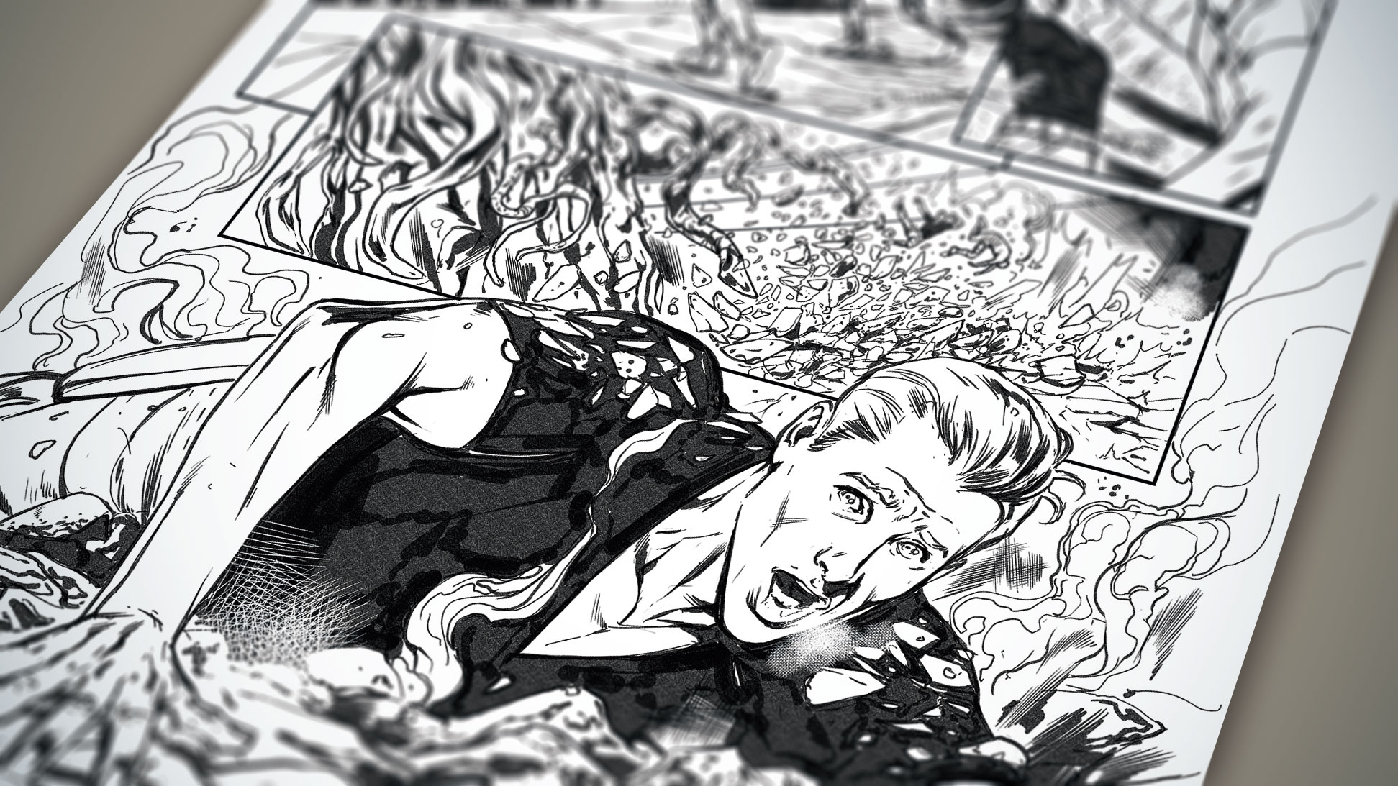
Image styles

Slide 12
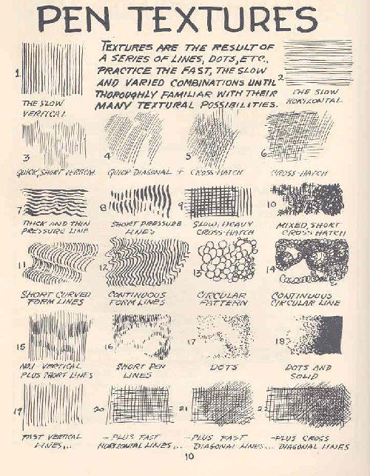
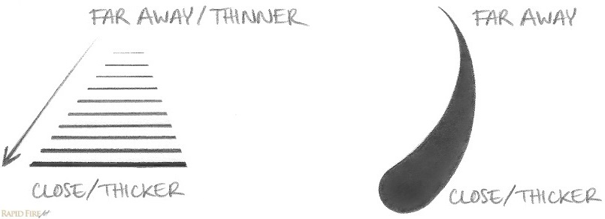
Line Weight

Slide 13
Notes:
Where do you see aspects of lineweight and texture?

Slide 14
2.
Comics 101
How to Read a Comic

Slide 15
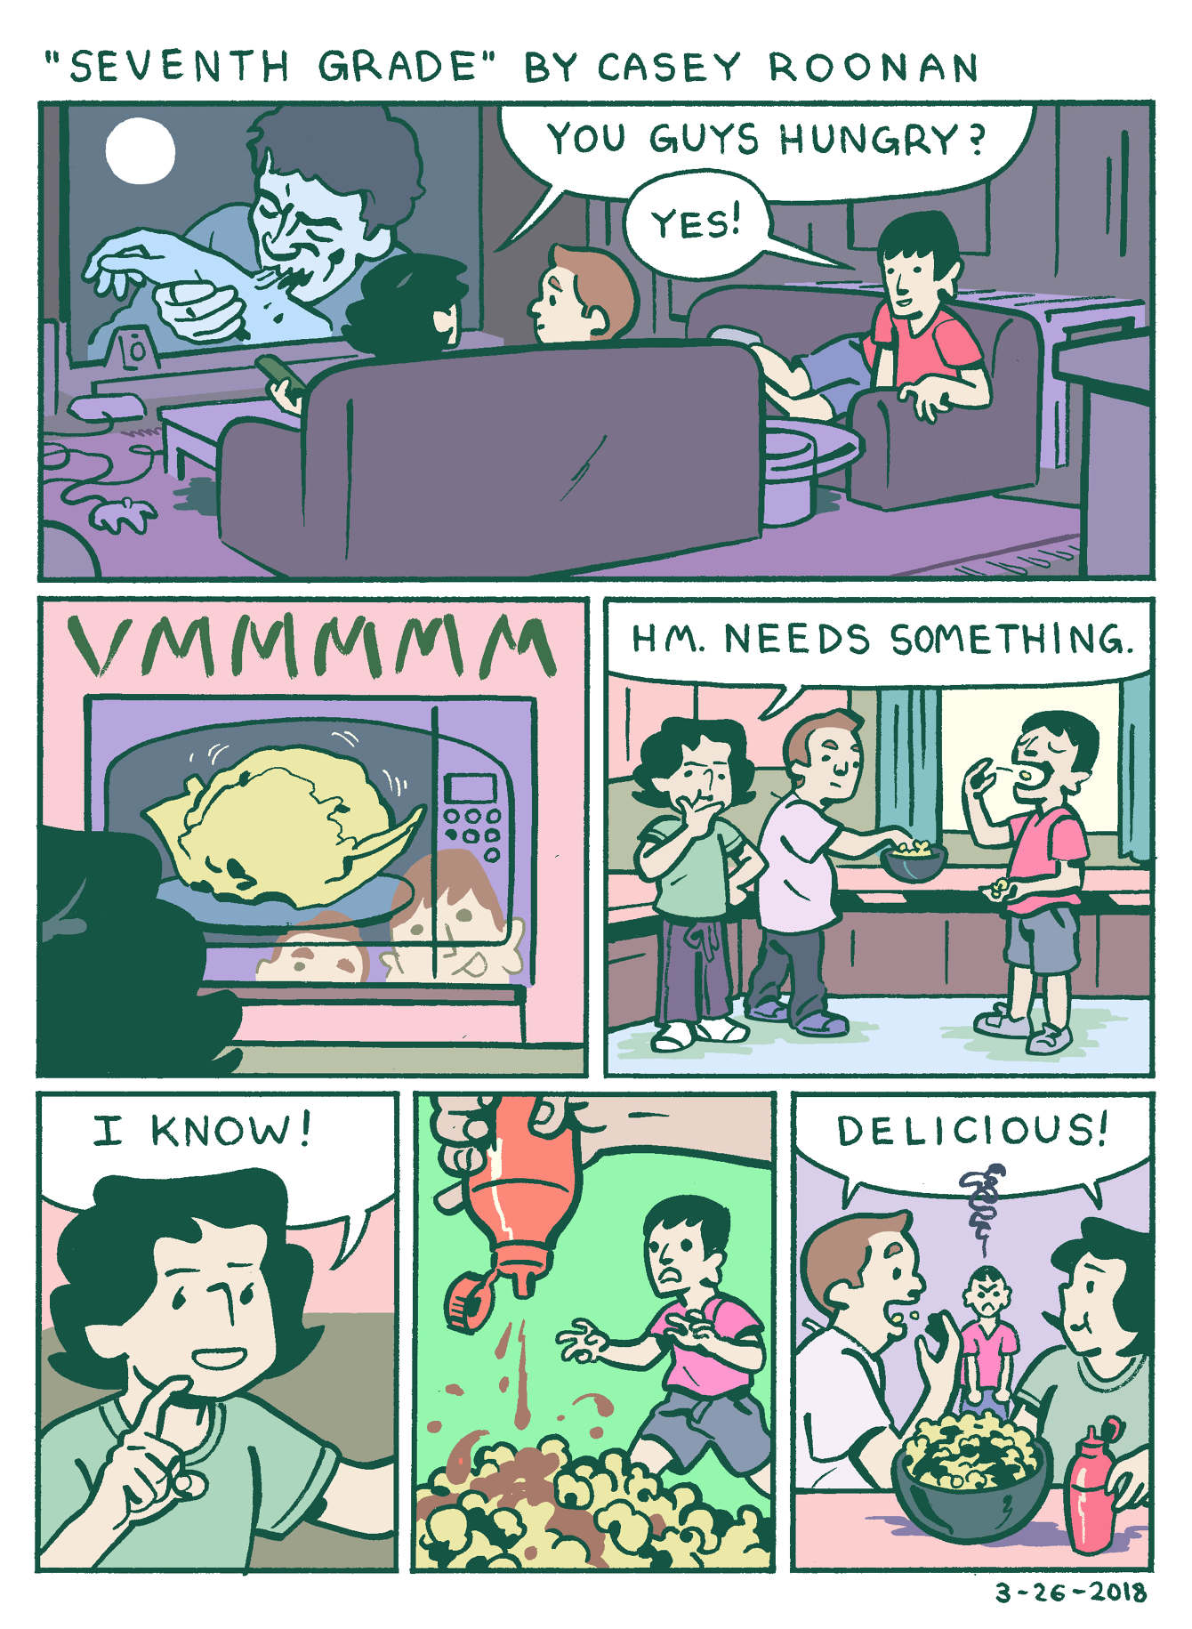
Parts of a Comic
Panels
(frame/box in which the story/images occur)

Slide 16
Parts of a Comic
Gutters
(empty spaces between panels that denote changes in time/space/event)

Slide 17
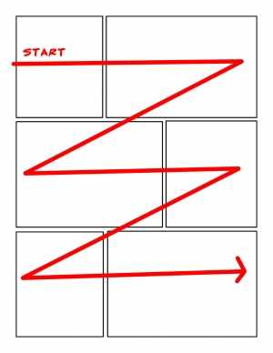
How to read it
Should be read in a “Z” formation

Slide 18
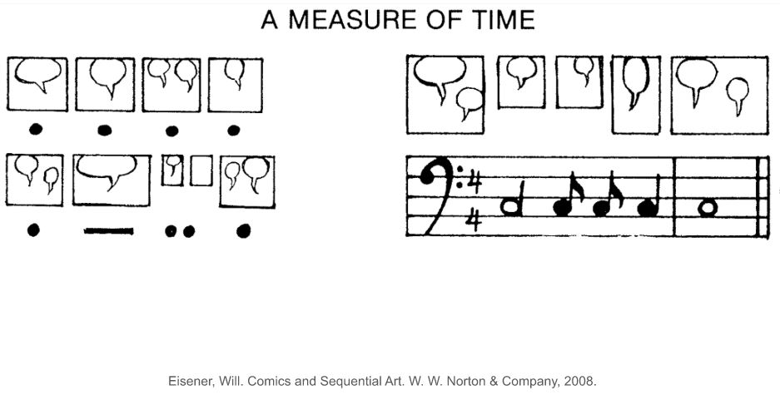
How to read it

Slide 19
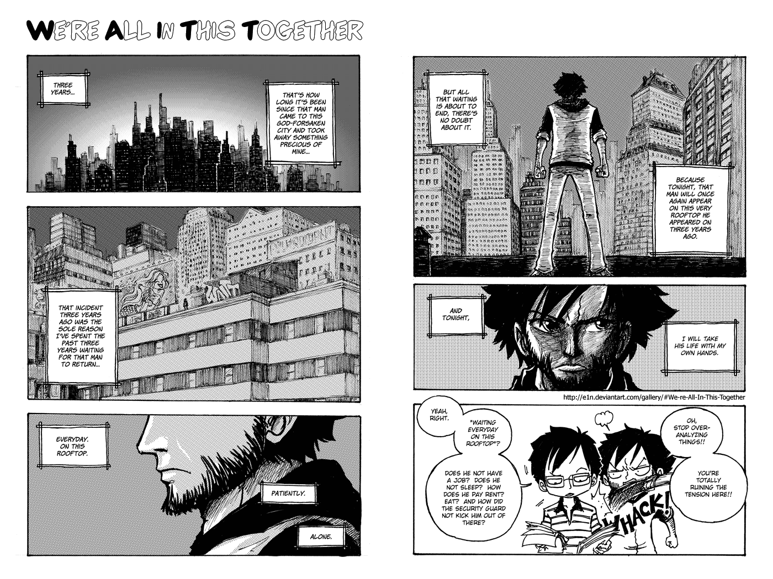
Different types of Scenes
Establishing
Long Shot
Close-up
Extreme Close-up
Medium Shot

Slide 20
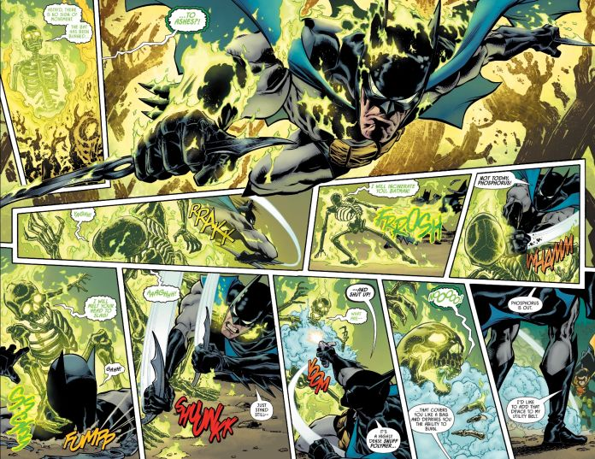

Slide 21
3. Our Project!!

Slide 22
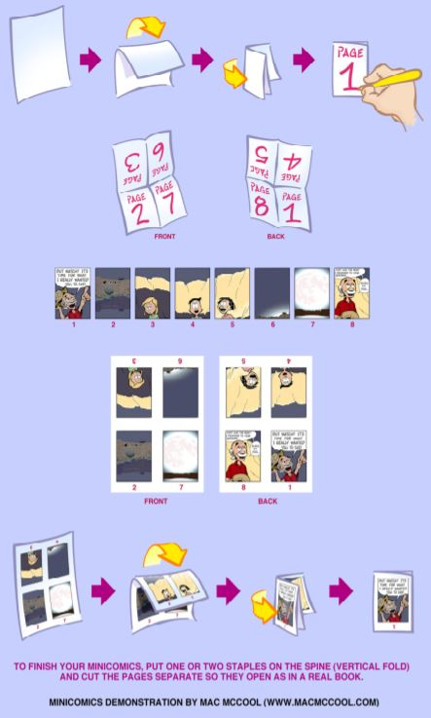
HOw to make the comic
Fold 2 papers into 4ths
Label each page (8 pages)
Draw your comic
Refold, cut and staple
I will demonstrate how to do this...

Slide 23
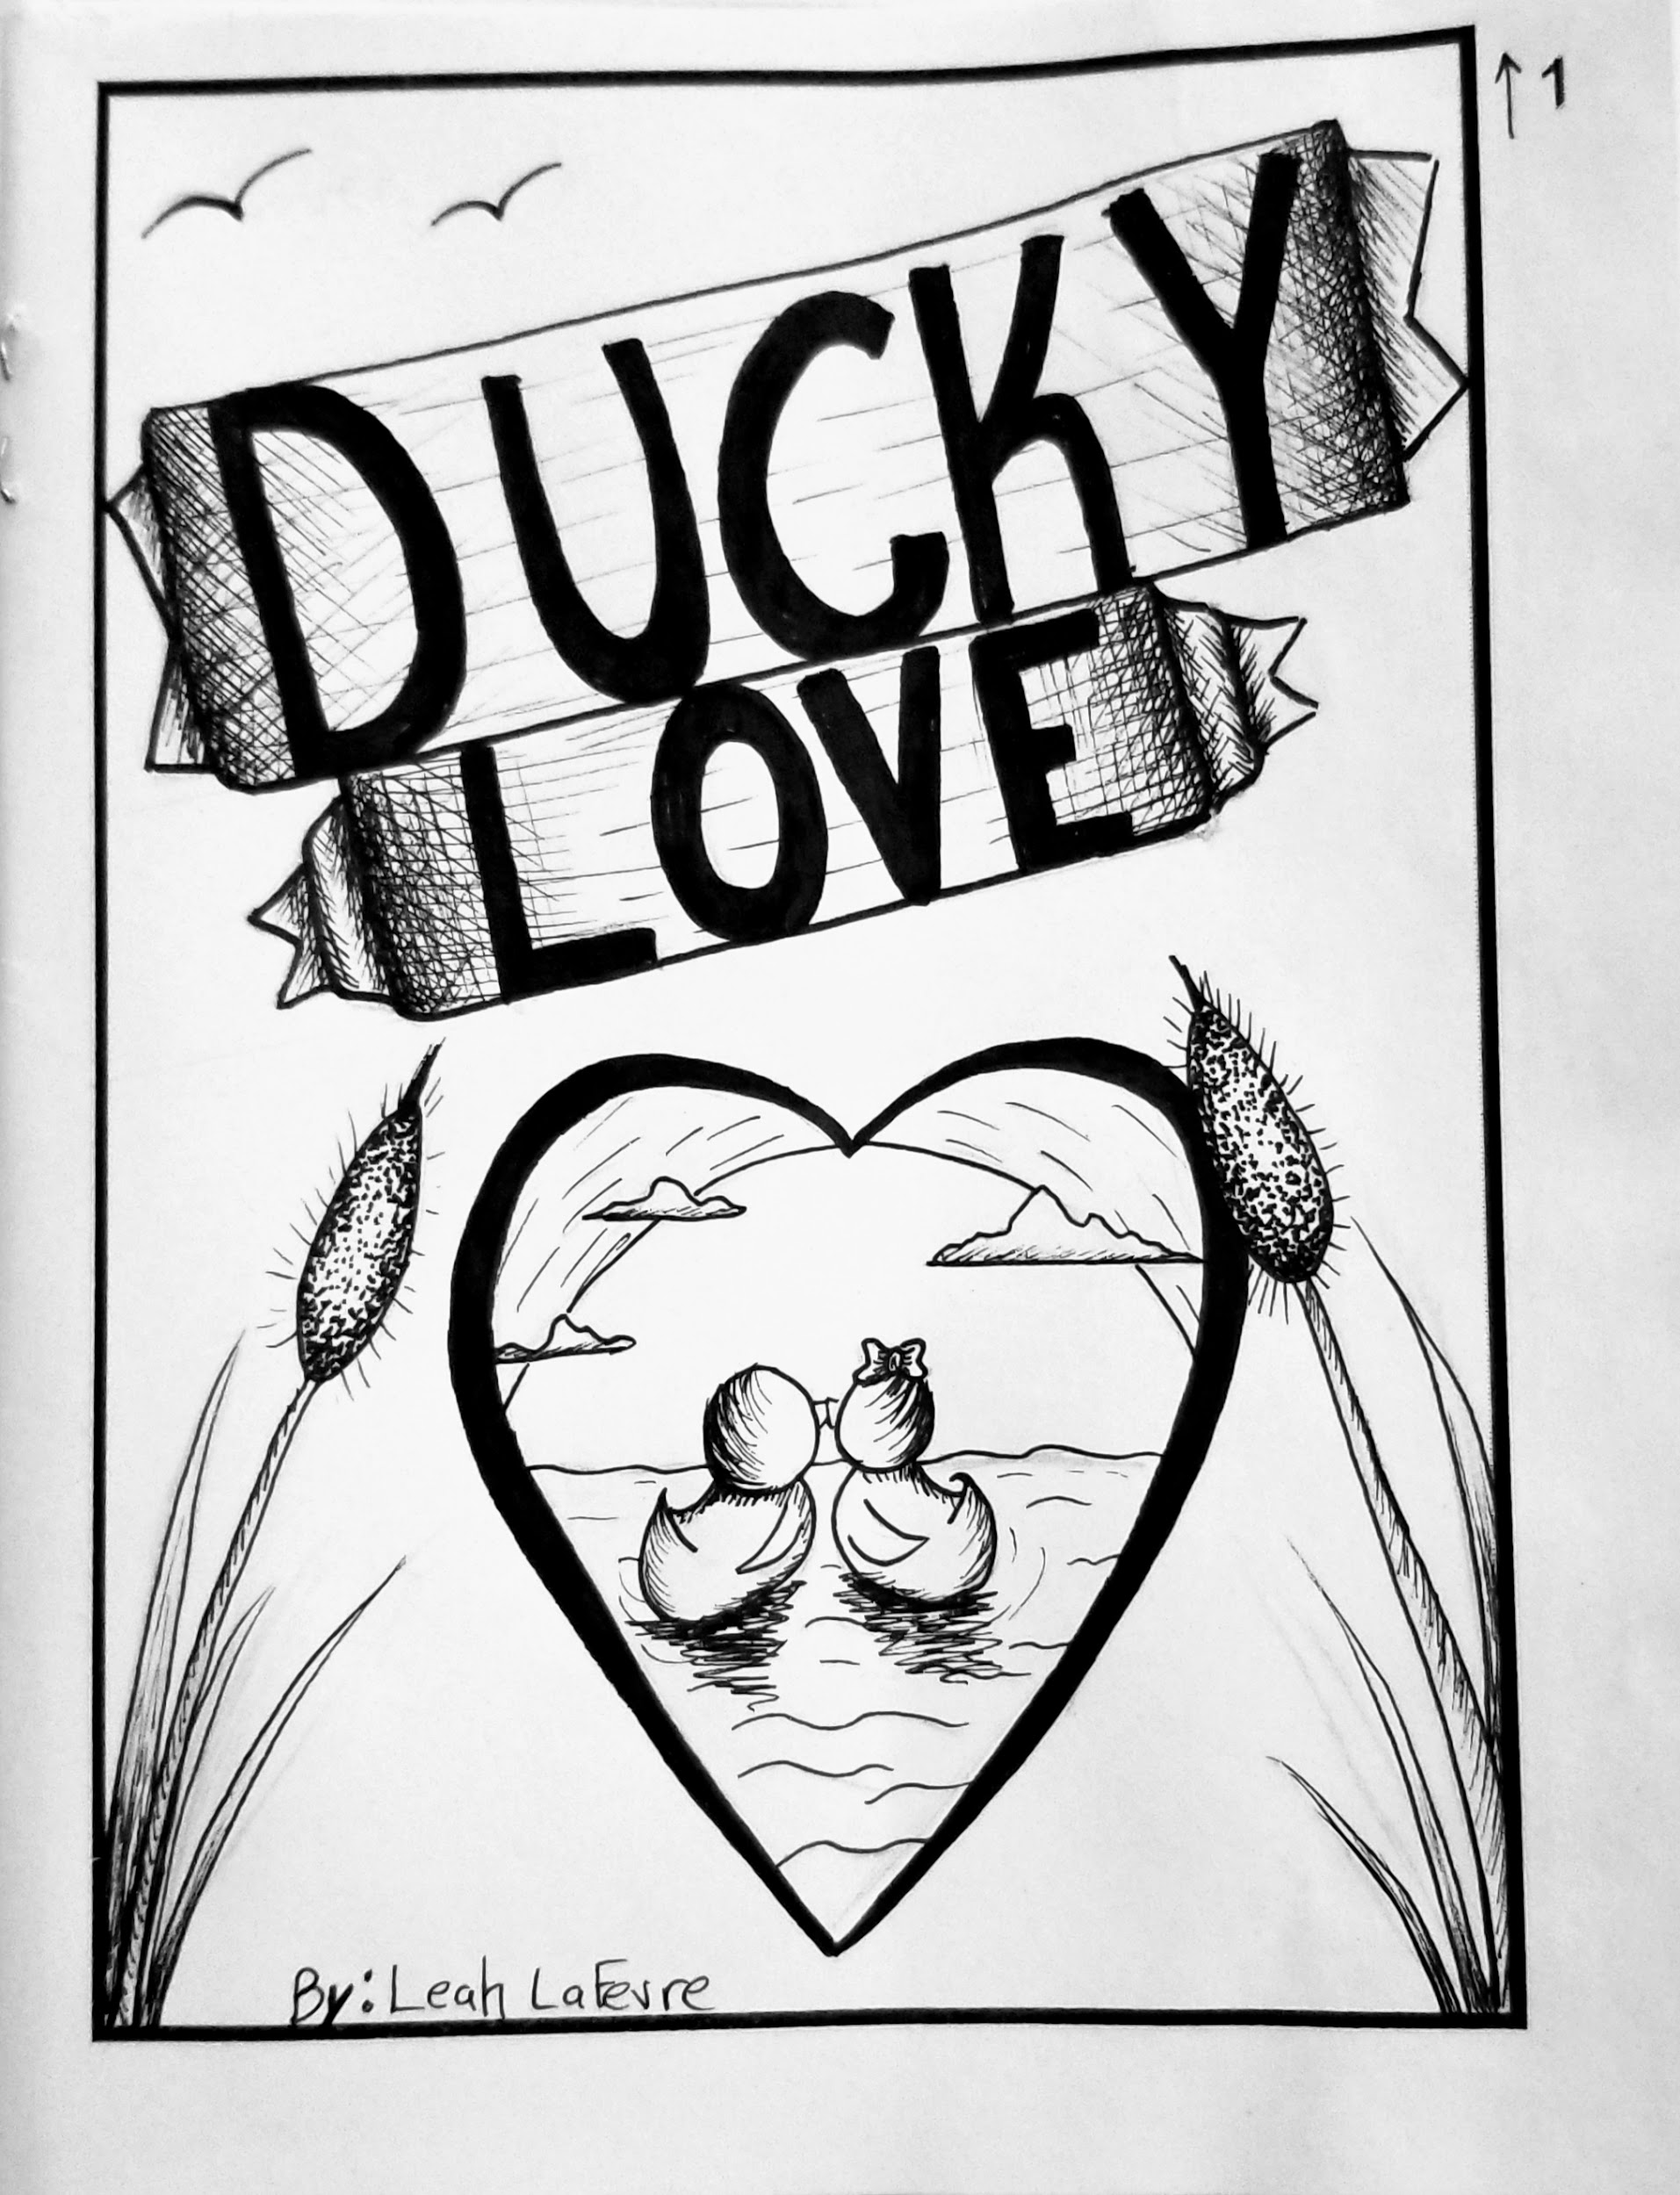
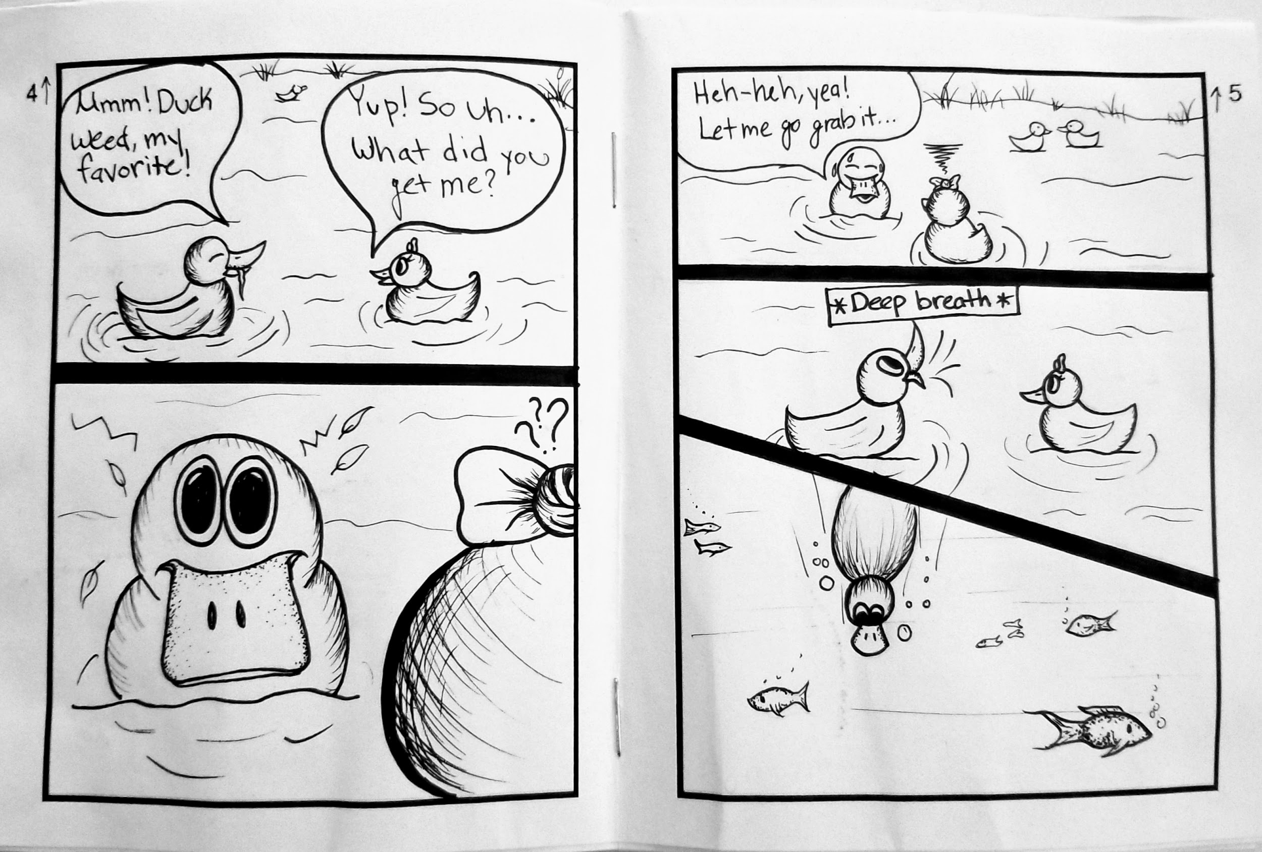
Our Project: Examples

Slide 24
Requirements
Must be in pen/ink
Must have aspects of fantasy and reality
  Fantasy creatures doing a real-life activity
  Real life characters doing fantasy things
  Fantasy story and creatures, life lesson meaning
8 pages
At least 8 panels (Title must be included on page one)
Must use at least 3 scene types (establishing, long, medium, close-up, extreme close-up)

Slide 25
For today
Begin brainstorming a story
Write down a summary of your story
Begin sketching character ideas
Draw a storyboard

Slide 26
2.
Comics: Day 2
Brainstorming Continued

Slide 27
Opening Activity: Kahoot!
https://create.kahoot.it/share/f0029231-66c3-47ec-b8e5-74d2c638ba8c

Slide 28
Requirements
Must be in pen/ink
Must have aspects of fantasy and reality
  Fantasy creatures doing a real-life activity
  Real life characters doing fantasy things
  Fantasy story and creatures, life lesson meaning
8 pages
At least 8 panels (Title must be included on page one)
Must use at least 3 scene types (establishing, long, medium, close-up, extreme close-up)

Slide 29
For Today...
Finish sketching and making your storyboard
Try to start on the final paper

Slide 30
3.
Comics: Day 3
Begin Drawing on Final Comic Paper

Slide 31
Opening Activity: Pass it Doodle
For this activity, you will...
Think of a short scenario/thing and write this in the first box
Give it to someone, they then must doodle what this scenario would look like
  Fold over the first box and pass
Then in the box under the doodle, guess what the scenario is, then pass

Slide 32
Opening Activity: Pass it Doodle
Ideas… *Must be school appropriate*
Movies
Characters
Celebrities
A thing
Food/Drinks
Sports

Slide 33
Requirements
Must be in pen/ink
Must have aspects of fantasy and reality
  Fantasy creatures doing a real-life activity
  Real life characters doing fantasy things
  Fantasy story and creatures, life lesson meaning
8 pages
At least 8 panels (Title must be included on page one)
Must use at least 3 scene types (establishing, long, medium, close-up, extreme close-up)

Slide 34
For today...
FINISH writing storyboard
Begin on final paper

Slide 35
4.
Comics: Day 4
Begin Drawing on Final Paper

Slide 36
Opening Activity: Kahoot!
Ask and thou shall receive!

Slide 37
Requirements
Must be in pen/ink
Must have aspects of fantasy and reality
  Fantasy creatures doing a real-life activity
  Real life characters doing fantasy things
  Fantasy story and creatures, life lesson meaning
8 pages
At least 8 panels (Title must be included on page one)
Must use at least 3 scene types (establishing, long, medium, close-up, extreme close-up)

Slide 38
For today...
FINISH your story board!!!!!
Begin drawing on final paper (in pencil first)
¡TERMINA tu storyboard!
Comience a dibujar en el papel final (primero con lápiz)

Slide 39
5.
Comics: Day 5
Continue working on Final Paper

Slide 40
For Today...
Continue working on FINAL paper
  Draw in pencil first, then add ink
  Don’t forget pen and ink techniques!

Slide 41
Requirements
Must be in pen/ink
Must have aspects of fantasy and reality
  Fantasy creatures doing a real-life activity
  Real life characters doing fantasy things
  Fantasy story and creatures, life lesson meaning
8 pages
At least 8 panels (Title must be included on page one)
Must use at least 3 scene types (establishing, long, medium, close-up, extreme close-up)

Slide 42
Citations
“Comic Theory for Kids: Teaching Students How to Read Comics”. Mr, Chan. South Hunterdon Regional High School. https://sites.google.com/a/shrsd.org/achan/nycc2019
“Creating and Self Publishing Your Minicomics”. Mac McCool. National Association of Comics Art Educators. https://www.cartoonstudies.org/wp-content/uploads/2014/06/MakingAMinicomics.pdf
http://mikedrinkwater.weebly.com/gags.html
https://en.wikipedia.org/wiki/Comics
https://the-artifice.com/guide-to-reading-comics-where-to-start/
https://en.wikipedia.org/wiki/Ch%C5%8Dj%C5%AB-jinbutsu-giga

Slide 43
Yellow
Is the color of gold, butter and ripe lemons. In the spectrum of visible light, yellow is found between green and orange.

