Slide 1
Obey: Inspiring Portraits of the 20th Century

Slide 2
1.
Shepard Fairey
Artist & Artworks

Slide 3
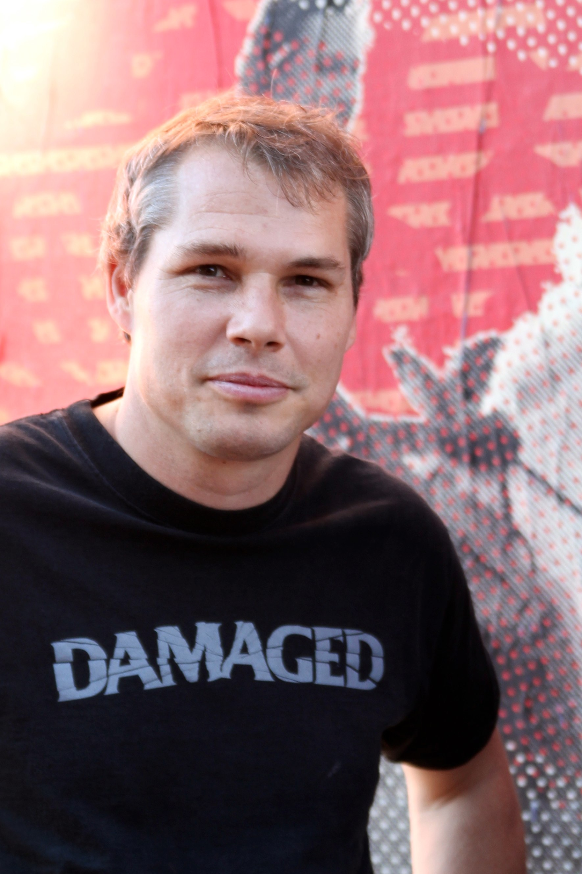
Who is Shepard Fairey
American Graphic Artist
Part of the “Street Art” Movement
Artista gráfico estadounidense
Parte del movimiento "Street Art"
Social Activist
(Activista social)
Notes:
Well known american graphic artist and social activist. He is also a skateboarder. His work is usually political, in that it addresses people in politics or political situations.

Slide 4

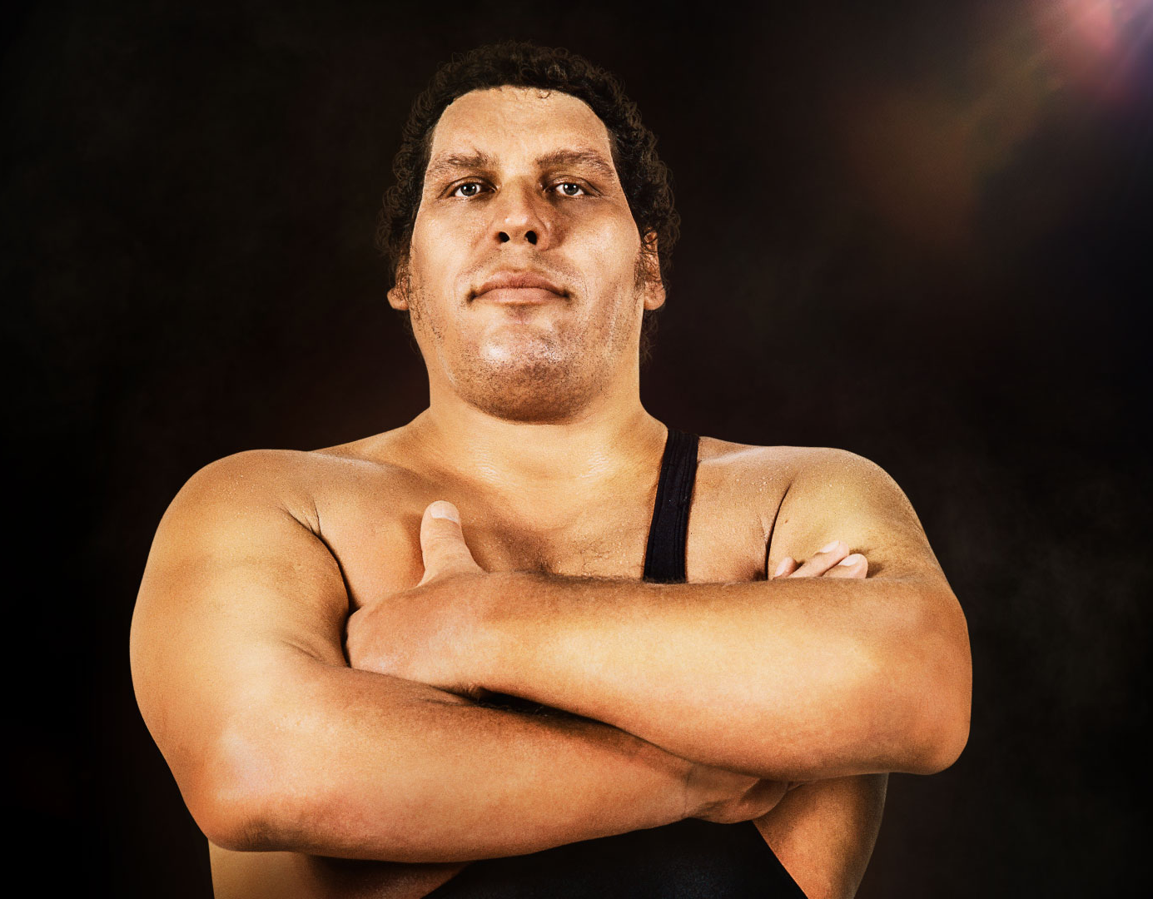
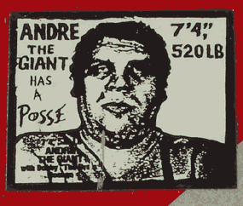
His Work (su trabajo)
Notes:
Image of Andre the Giant, the images/”obey” have no meaning. They are used to experiment with phenomenology - reactions people have when viewing something for the first time
The image is ambiguous. Leaving the viewer to use their own opinions to decipher what they think the image means

Slide 5
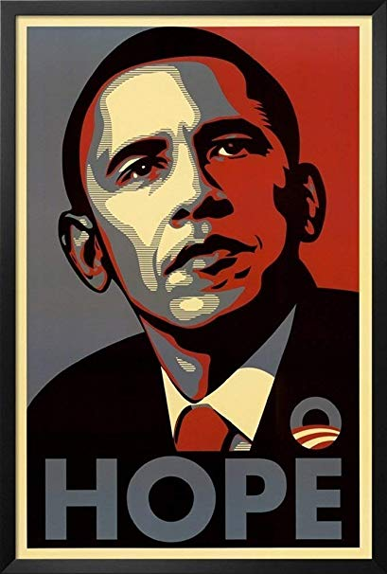
Notes:
Most well known for his “Hope” poster of former President Obama, 2008

Slide 6
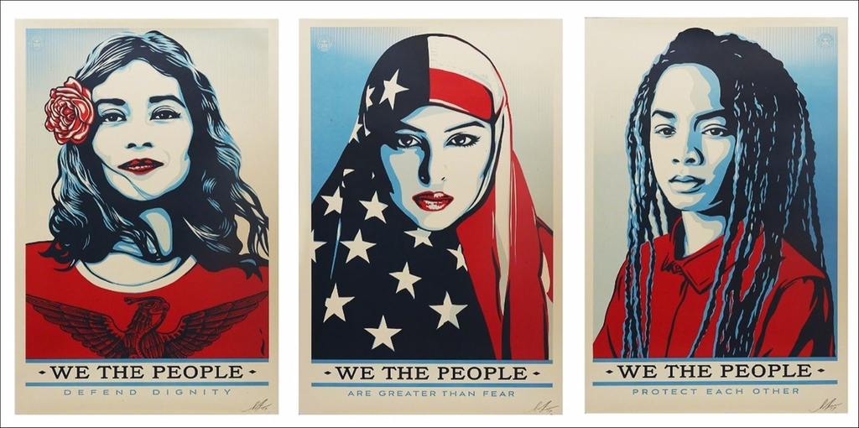
Notes:
Created during the “rise” of Donald Trump's campaign and presidency as a response to his rhetoric about women and minorities in America, 2017

Slide 7
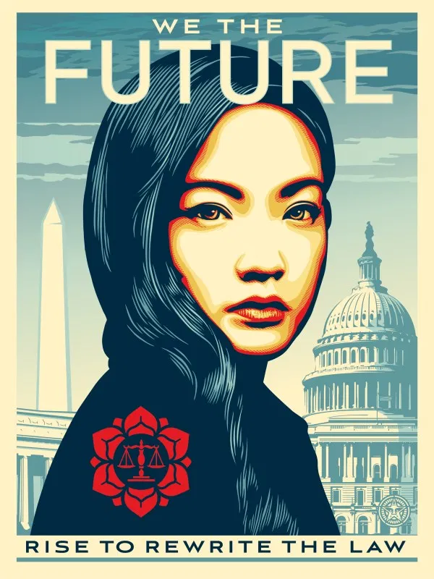
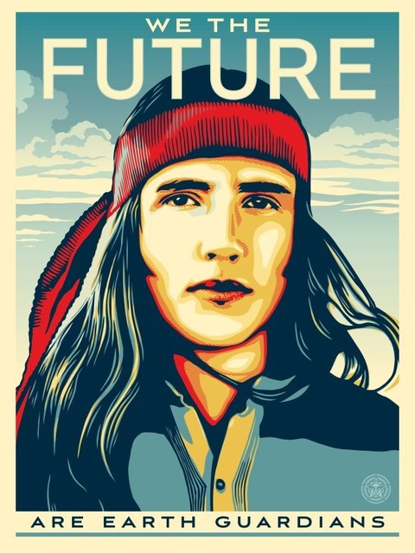
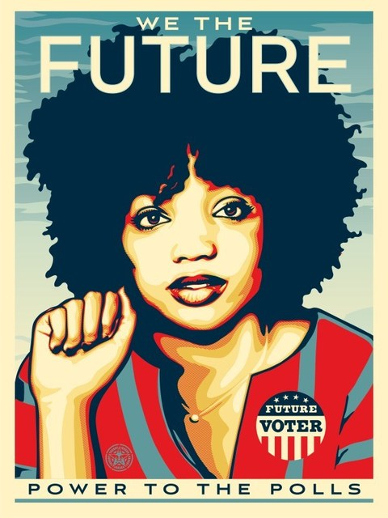
Notes:
These are a series created for the “We the Future” campaign, showcasing 3 youth leaders. This campaign is designed to place artwork in classrooms that show student leaders as a way to inform students about current events and what others are doing about it.

Slide 8
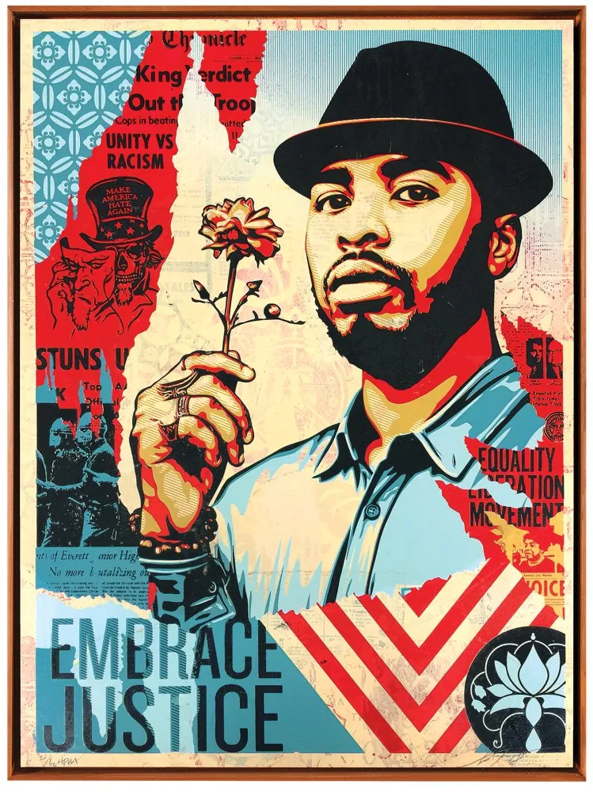
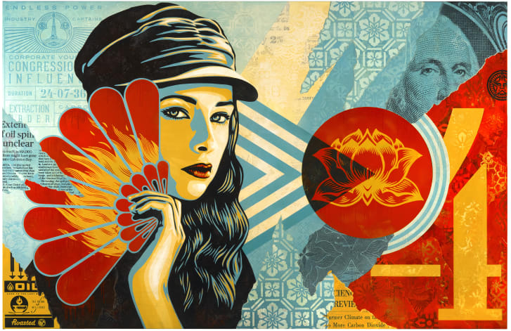
Notes:
His most recent works now include collage in the background. He still keeps a posterized style.
Discussion:
After viewing his works, how would you describe his style, technique, meaning?
How does he use color to create form?

Slide 9
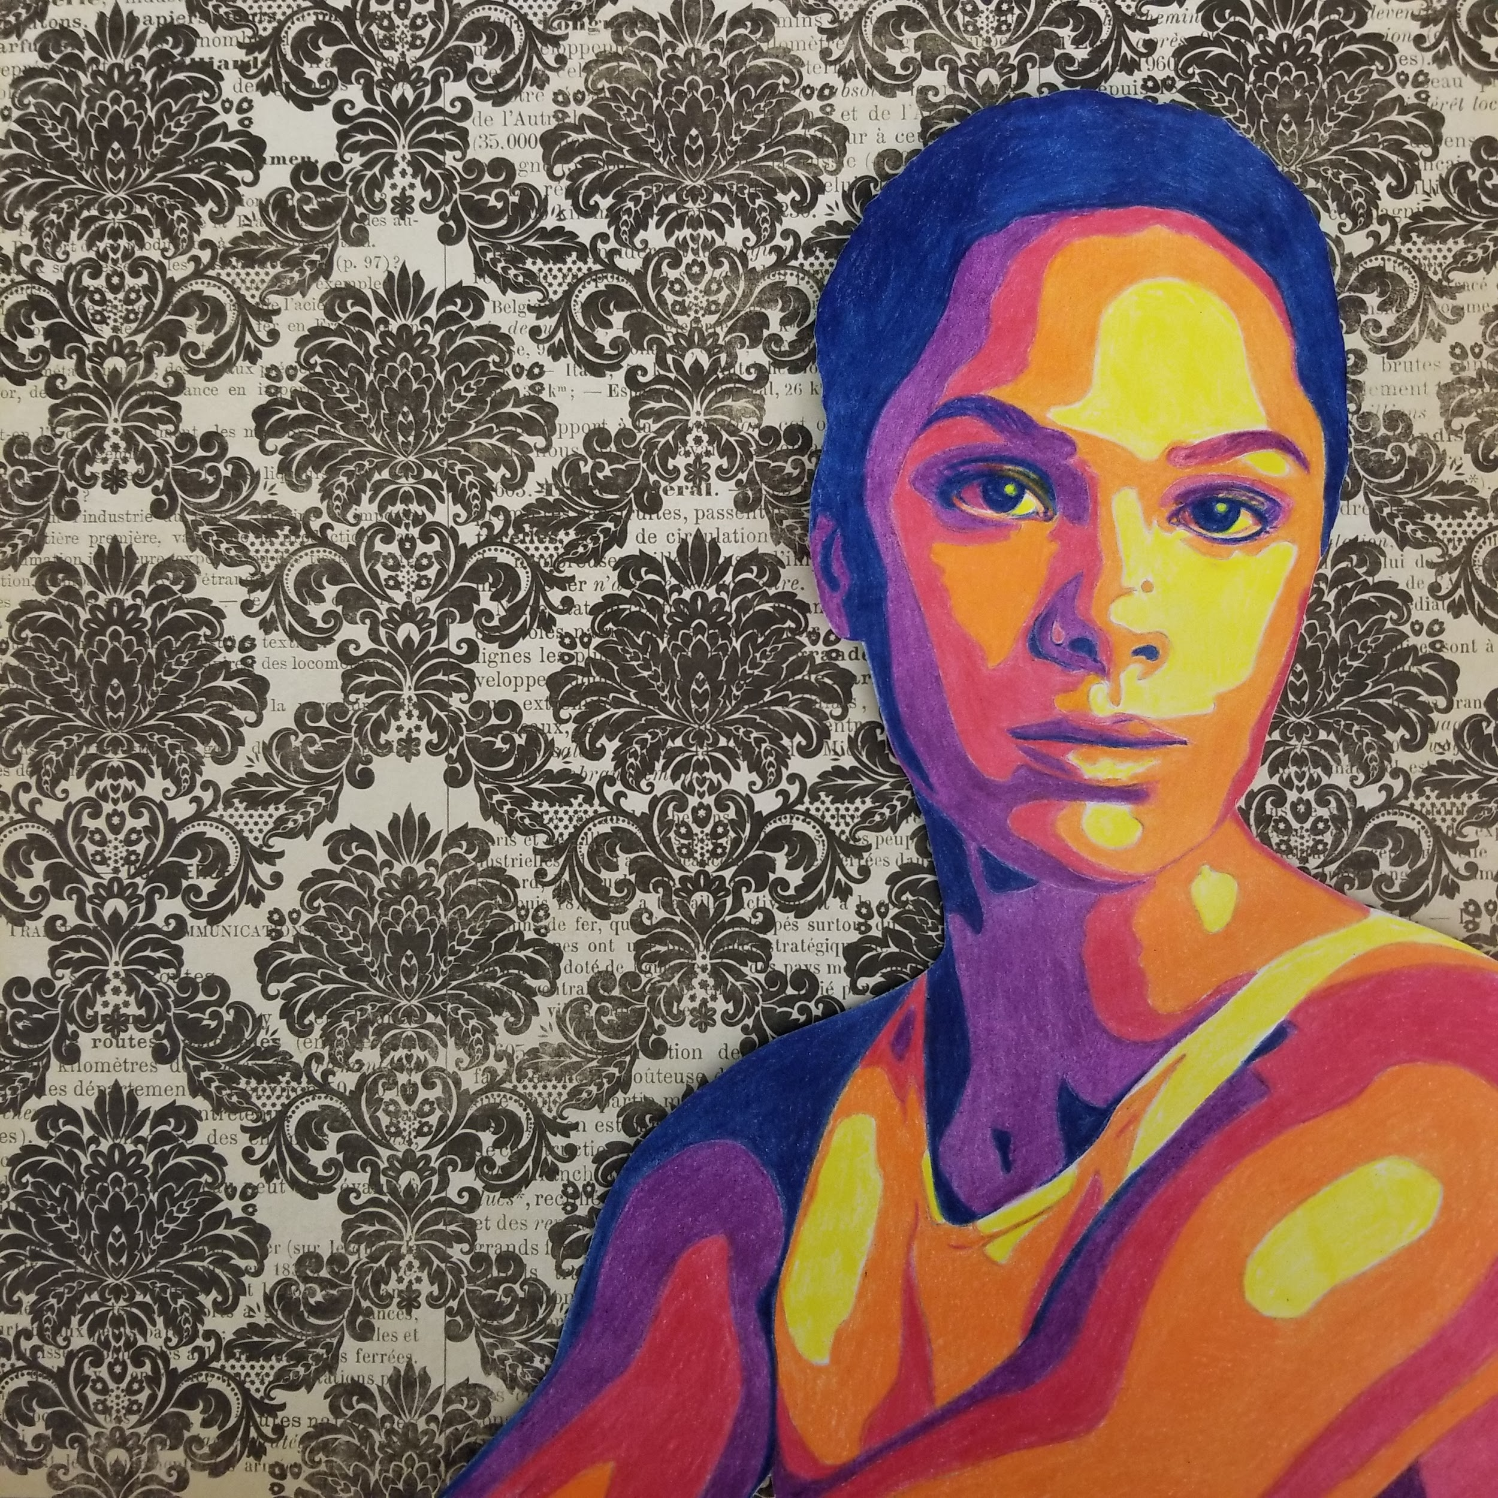
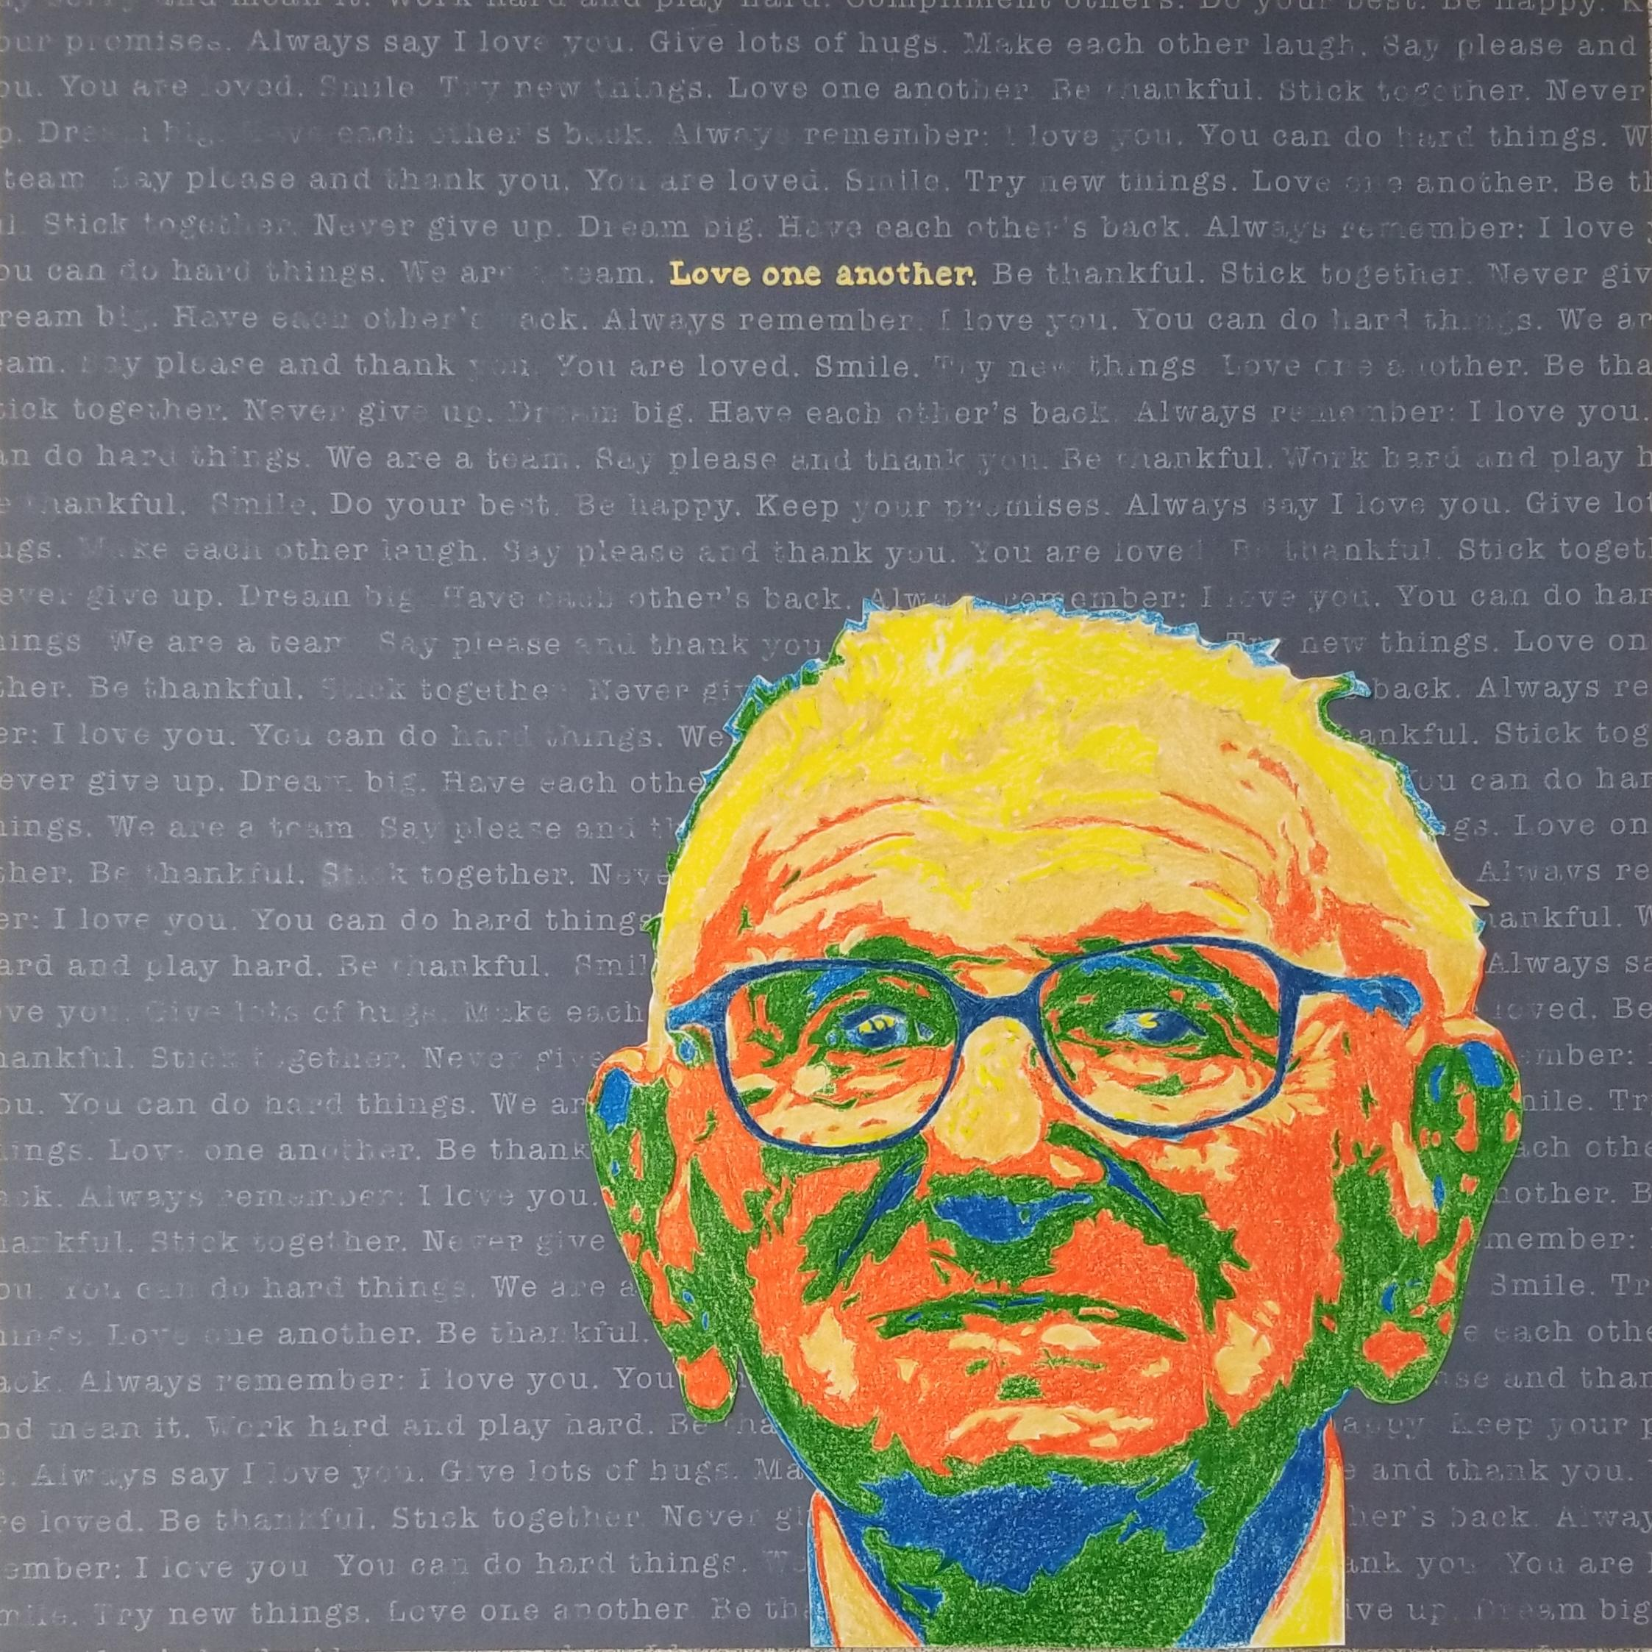
Our Project (Nuestro Proyecto)

Slide 10
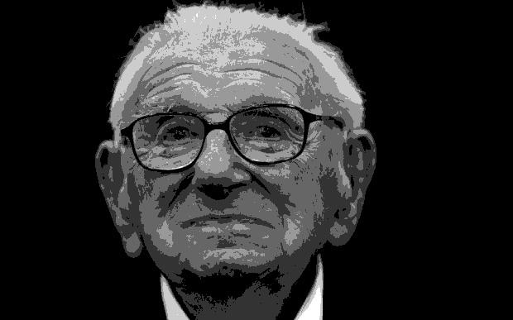
Select a Person & Posterize on Photoshop
(Seleccione una persona y posterice la foto en photoshop)
Sir Nicholas Winton
Notes:
Pick someone who inspires you, not someone random.

Slide 11
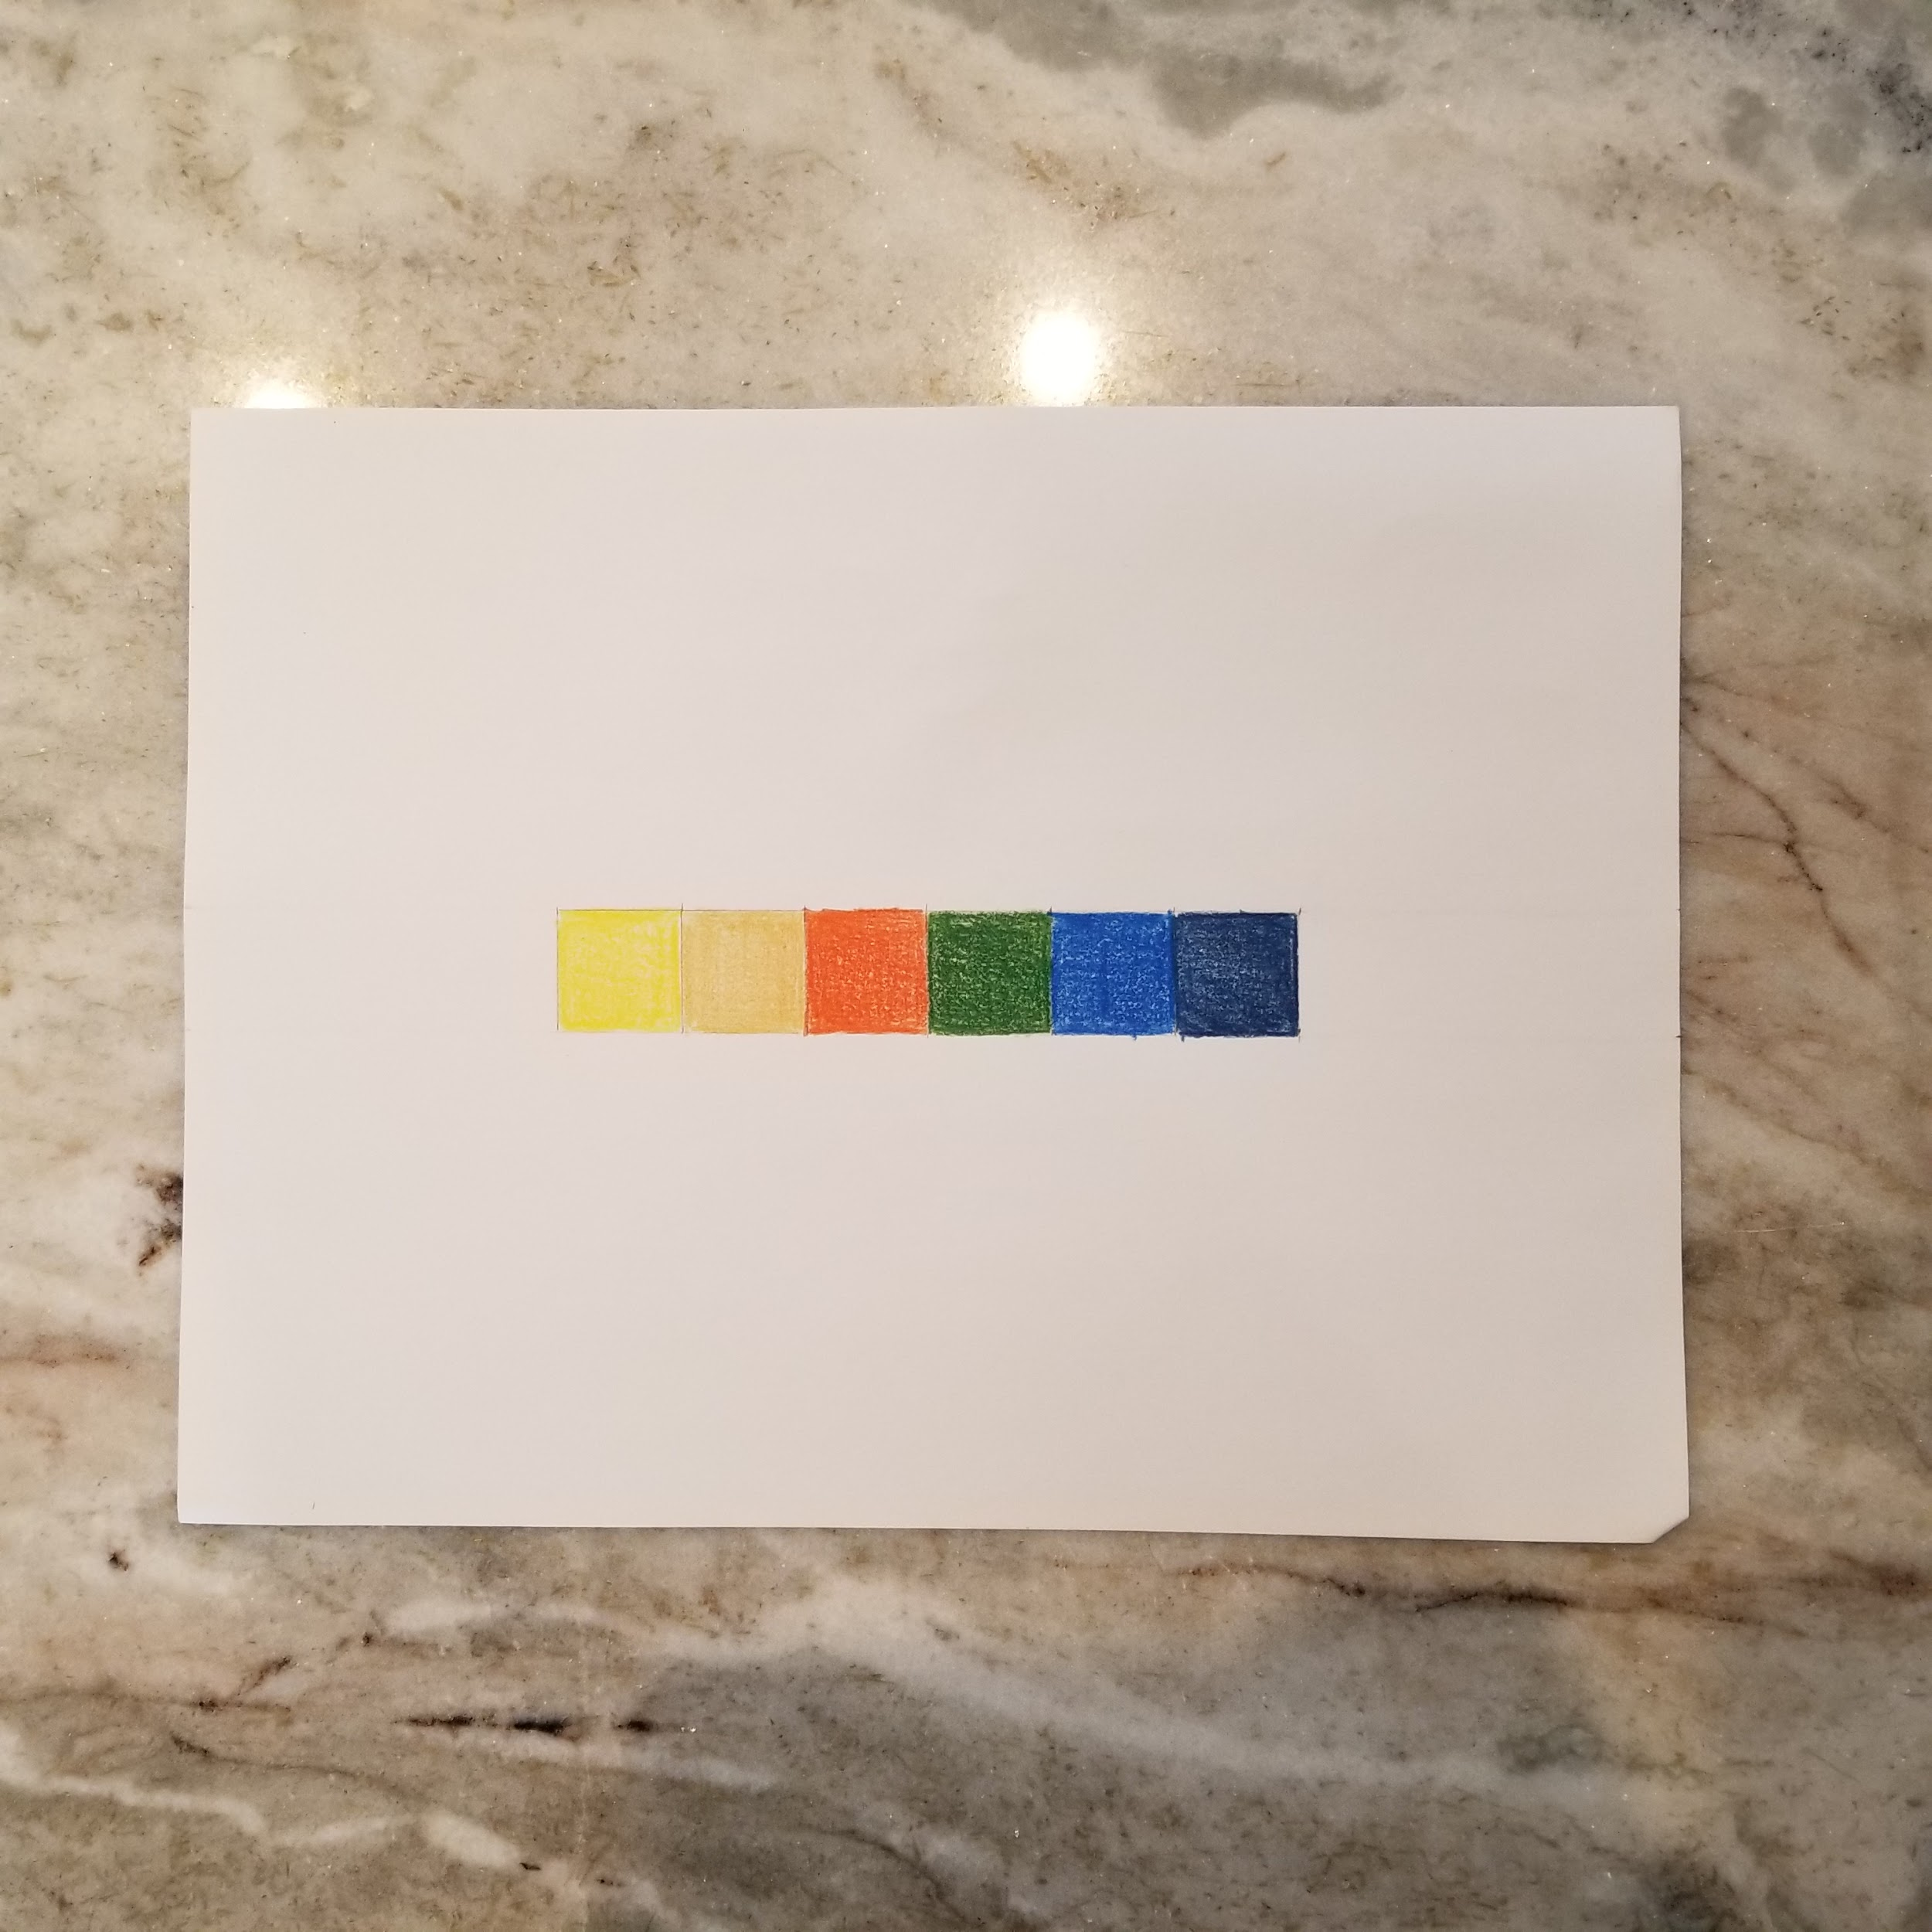
Color Value Scale
(Escala de valor de color)

Slide 12
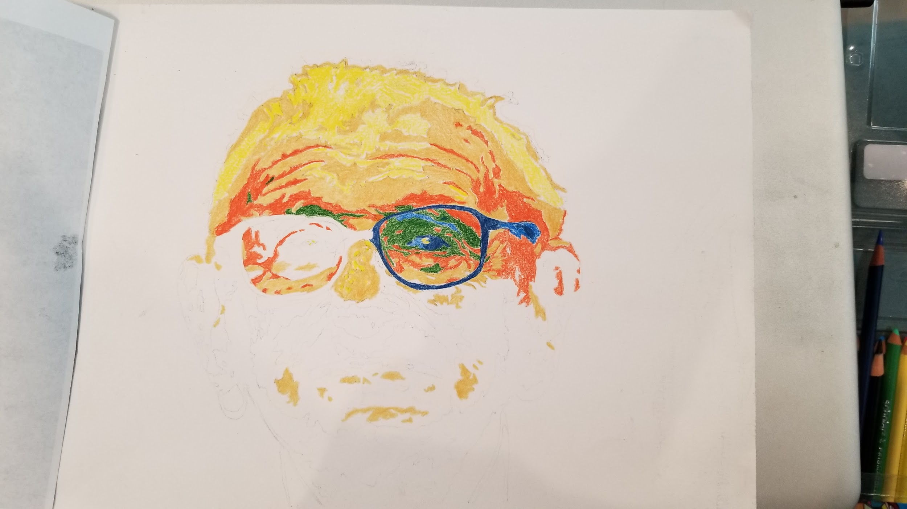
Transfer/Color The Image & Paste on Background
(Transferir / colorear la imagen y pegar en el fondo)

Slide 13
Requirements
Photo: Someone from history (20th cent.) that inspires you
  Clear, close up photo, fits page, good contrast
  Can’t be an image of a drawing/painting
Color: 5-7 values, multicolored
Foto: alguien de la historia que te inspira
  Claro, foto de primer plano, se ajusta a la página, buen contraste
  No puede ser un imagen de un dibujo / pintura
Color: 5-7 valores, multicolor

Slide 14
Posterize your image on...
Pixlr.com
We will do this together

Slide 15
Ms. LaFevre’s Email
lafevrl1@tcnj.edu

Slide 16
Day 2
Inspiring Figures

Slide 17
Opening Activity (actividad de apertura)
Answer the question on the slip of paper you get.
  Responda la pregunta en el trozo de papel.
DON’T put your name on it
  No pongas tu nombre en él.
When everyone has finished answering the question, we will crumple up the paper and throw it to another side of the room.
  Cuando todos hayan terminado de responder la pregunta, arrugaremos el papel y lo tiraremos al otro lado de la habitación.
You pick up a paper by your seat and read it allowed
  Coges un papel de tu asiento y lo lees permitido.

Slide 18
Entrance Slip Questions
How do historical/important figures impact us today? (Thoughts and actions)
  ¿Cómo nos impactan hoy las figuras históricas / importantes? (Pensamientos y acciones)
How can society influence, impact, or inspire art/artists?
  ¿Cómo puede la sociedad influir, impactar o inspirar arte / artistas?

Slide 19
For today...
Requirements
Finish transferring your image
Choose colors and make colored value scale
Work on coloring your image
Photo: Someone from history (20th cent.) that inspires you
  Clear, close up photo, fits page, good contrast
  Can’t be a photo of a drawing/painting
Color: 5-7 values, multicolored

Slide 20
Day 3
Inspiring Figures

Slide 21
Opening Activity (actividad de apertura)
https://pollev.com/leahlafevre659

Slide 22
Color Value Scale
(Escala de valor de color)
# values = # of colors
4 in.
2 ½ in. or more
2 ½ in. or more
4 in.

Slide 23
Coloring in Your Portrait
Match the color with the value

Slide 24
For Today...
Requirements
Finish making colored value scale
Begin coloring
Photo: Someone from history (20th cent.) that inspires you
  Clear, close up photo, fits page, good contrast
  Can’t be a photo of a drawing/painting
Color: 5-7 values, multicolored (# of values = # of colors)

Slide 25
Day 4
Inspiring Figures

Slide 26
For Today...
Requirements
Continue coloring (try to finish)
Cut out your portrait and pick out a patterned background
Photo: Someone from history (20th cent.) that inspires you
  Clear, close up photo, fits page, good contrast
  Can’t be a photo of a drawing/painting
Color: 5-7 values, multicolored

Slide 27
Day 5
Inspiring Figures

Slide 28
Final Work Day
Finish coloring
Write portrait description/explanation
Terminar de colorear
Escribir descripción / explicación del retrato

Slide 29
Portrait Description/Explanation
(Descripción del retrato)
**On Google Classroom, write this in a speech bubble on a slide with a partner**
My name is (person’s name)
I did/was/am _________________.
I inspire others by ________________.
Mi nombre es (nombre de la persona inspiradora)
soy un ____________.
Inspiro a otros a _____________.

Slide 30
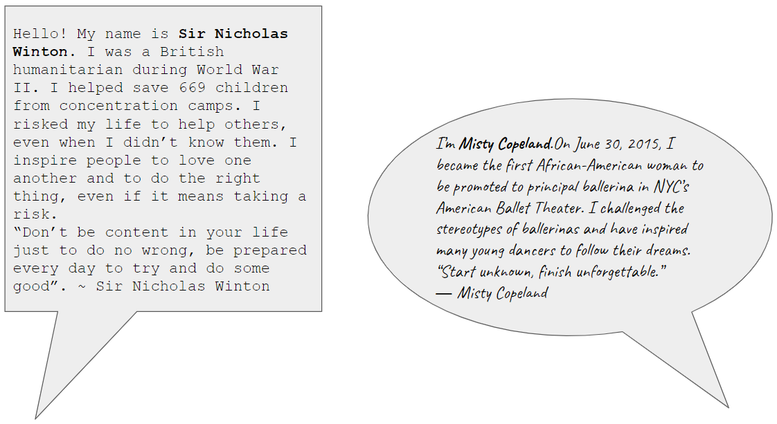

Slide 31
Citations
http://www.artnet.com/artists/shepard-fairey/
https://en.wikipedia.org/wiki/Shepard_Fairey

