Slide 1
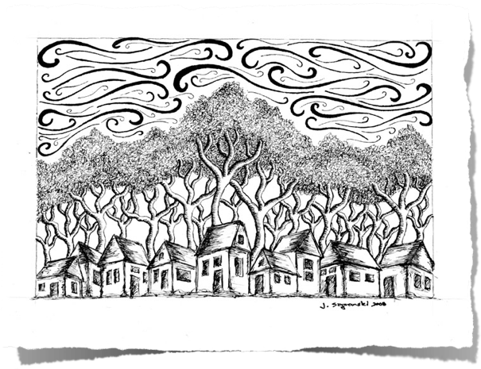
PEN & INK
ART ONE

Slide 2
PENS
Crow Quill Pen: Beautiful line quality, dark black ink, but may leak or splatter.
Felt Tipped Pen: Fair line quality. Will not splatter. Pens can dry up or not be true black. Tends to “bleed” around edges.
Technical Pen: Excellent line quality. No need to stop to refill. Can work at many angles. Can be expensive.
Fountain Pen: A nib pen with an ink reservoir inside for continuous application
Ballpoint Pen: OK line quality in a pinch, can smear or not be true black.
    Gel Pens

Slide 3
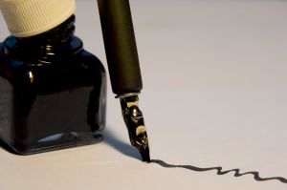
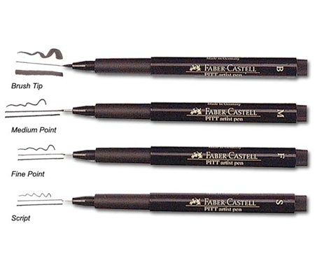
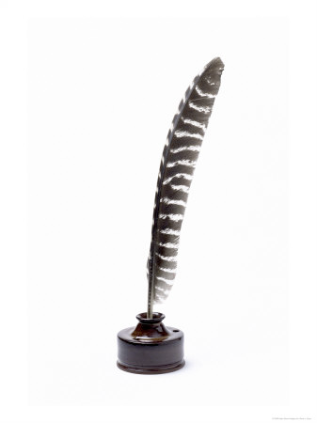
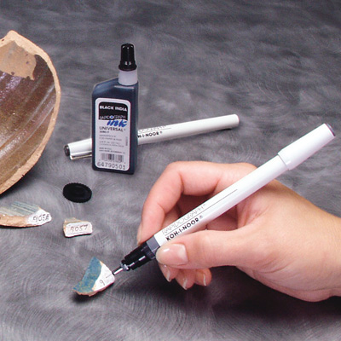
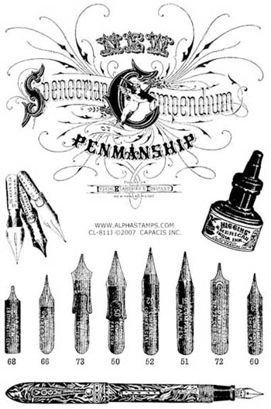
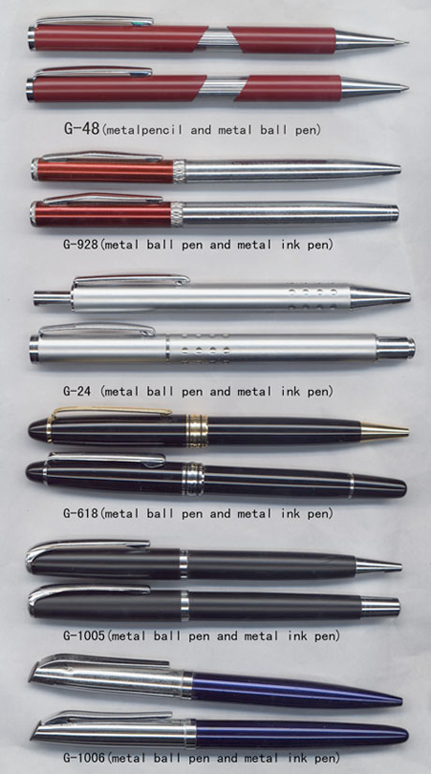
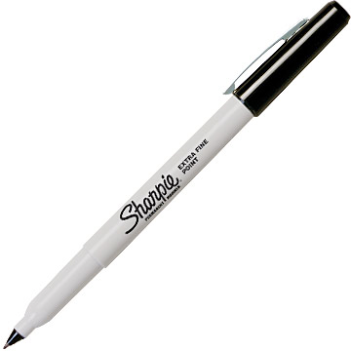
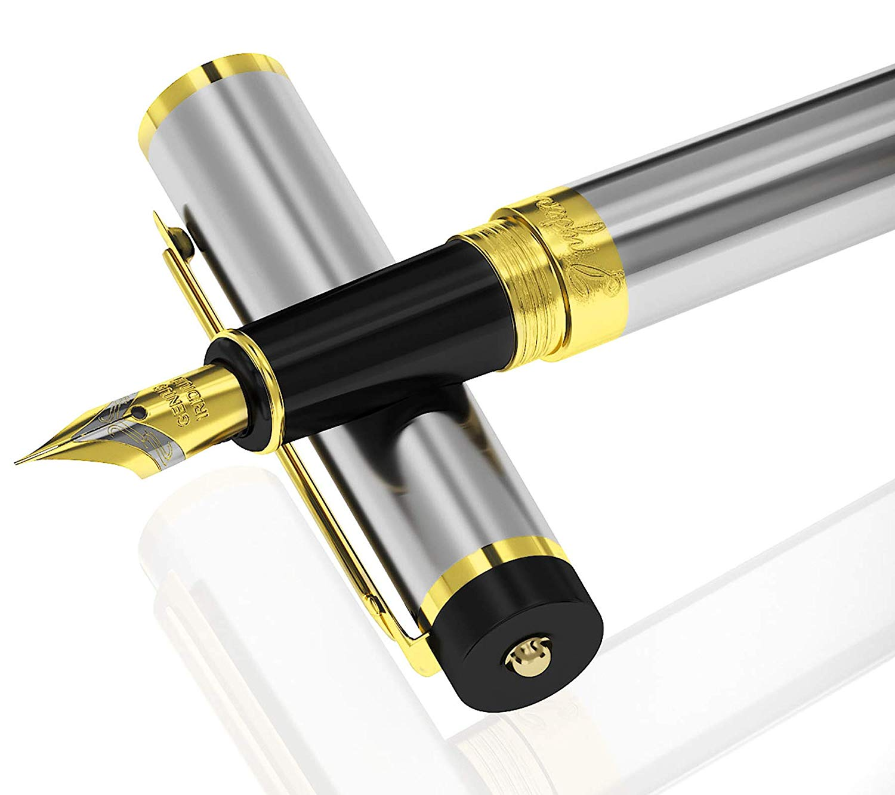

Slide 4
DRAWING SURFACES
Vellum
Illustration Board
Bristol Paper
Watercolor Paper
Rice Paper

Slide 5
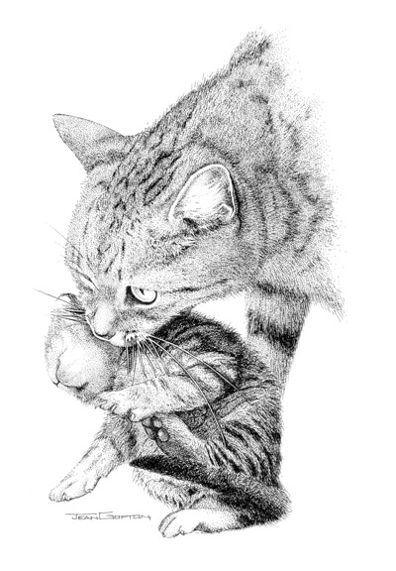
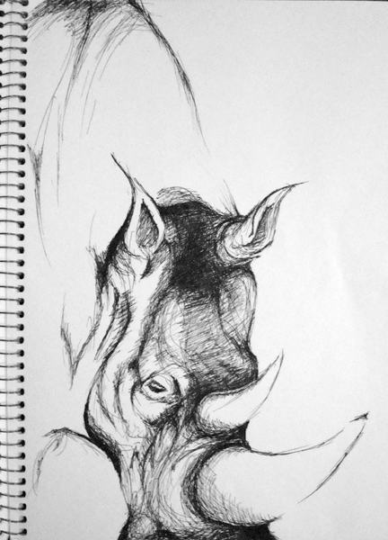
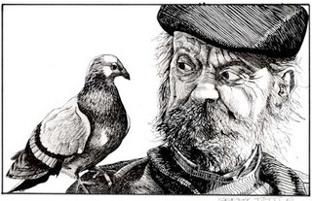
TECHNIQUE
The three techniques of pen & ink are: Hatching, cross-hatching and stippling.

Slide 6
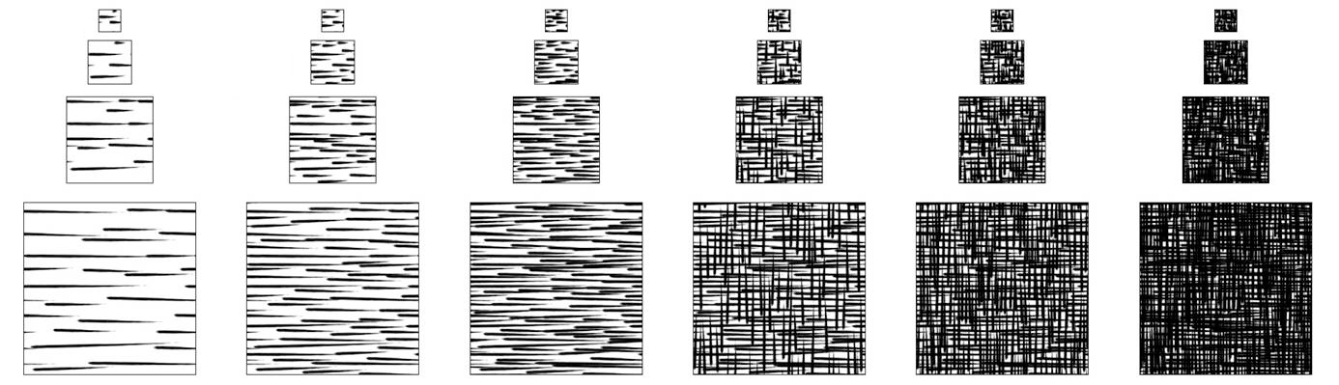
Hatching and Cross-Hatching
What happens as you add more lines?
What happens when the lines are closer together?
What happens if the lines are further apart?

Slide 7
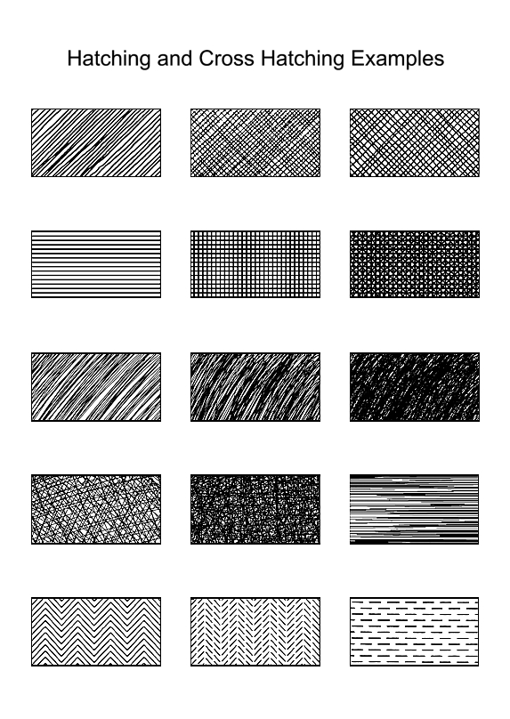
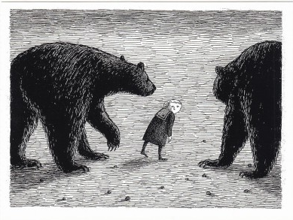
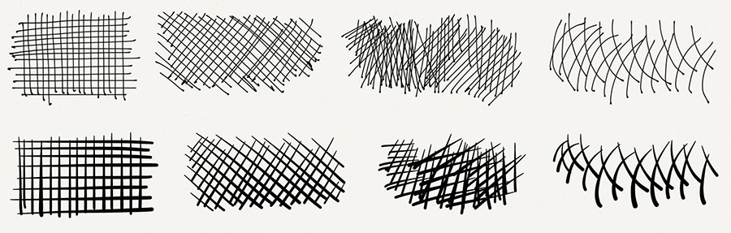

Slide 8
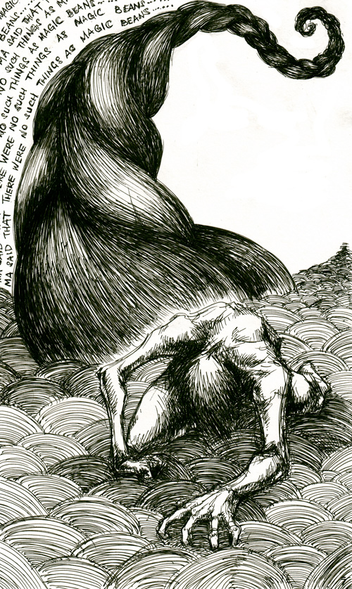

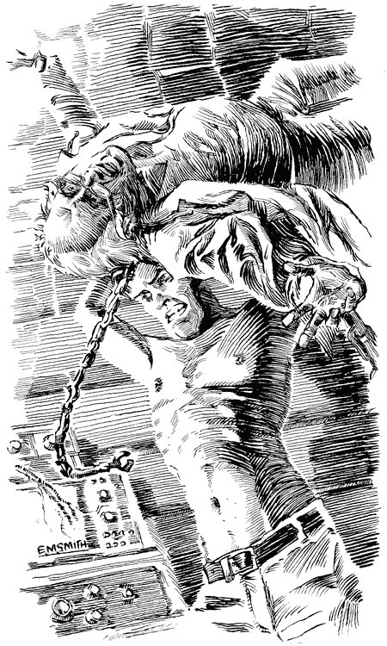
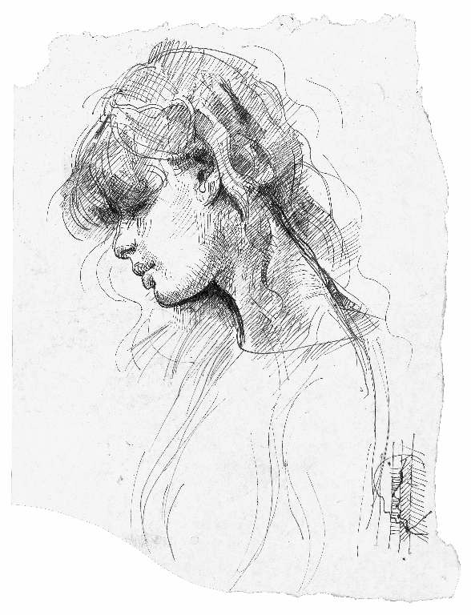
HATCHING AND CROSS-HATCHING EXAMPLES

Slide 9
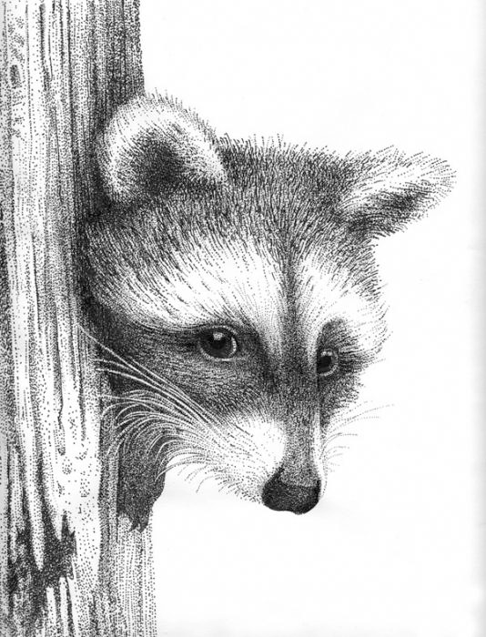
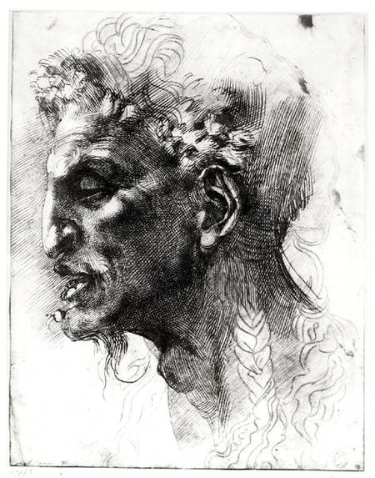

Slide 10
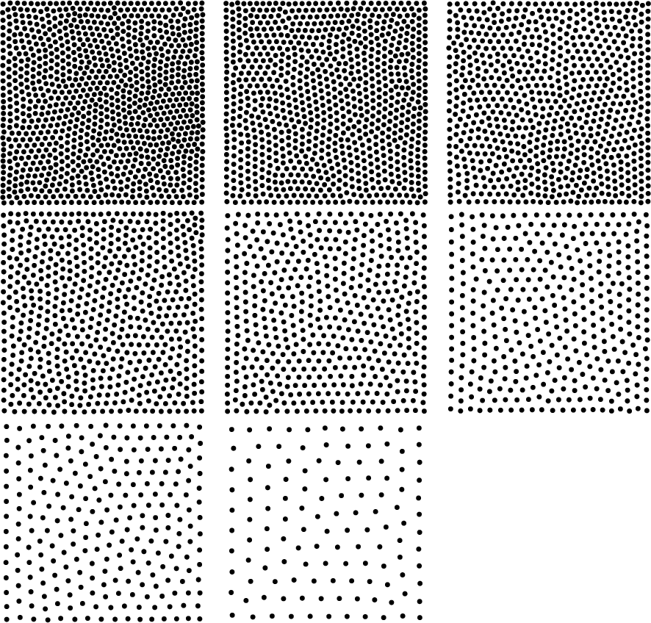
STIPPLING
What happens as you add more dots or fatter dots?
What happens when the dots are closer together?
What happens if the dots are further apart?

Slide 11
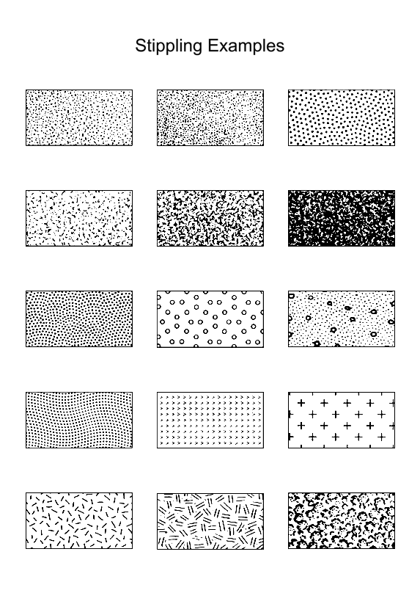
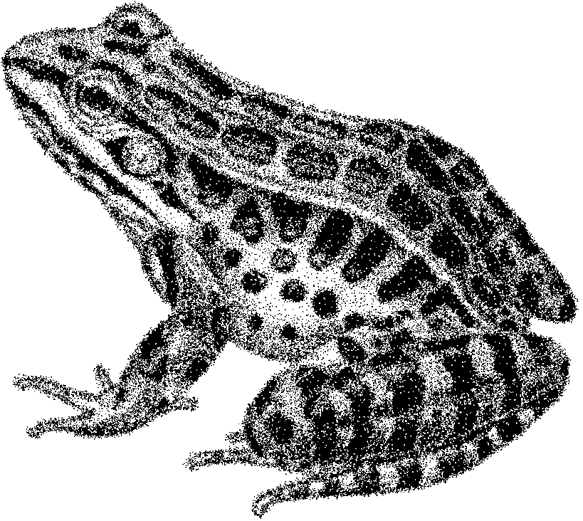
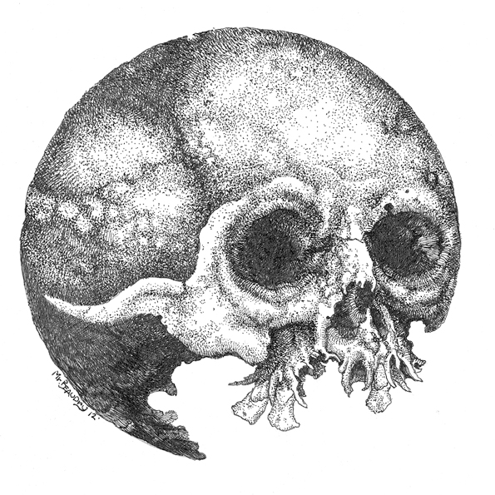

Slide 12
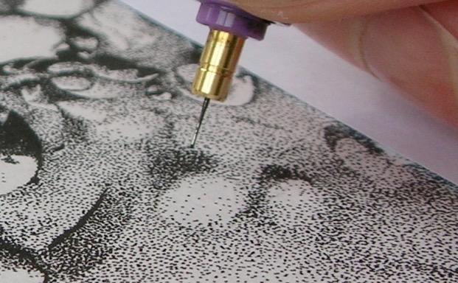
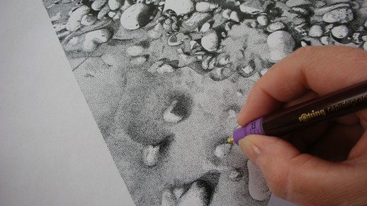

Slide 13
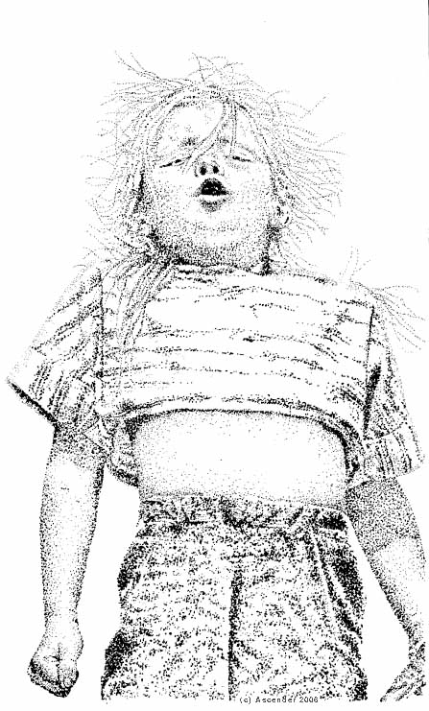
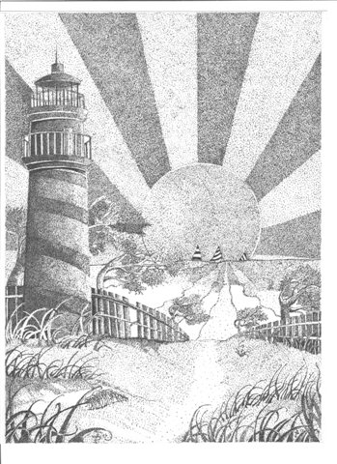
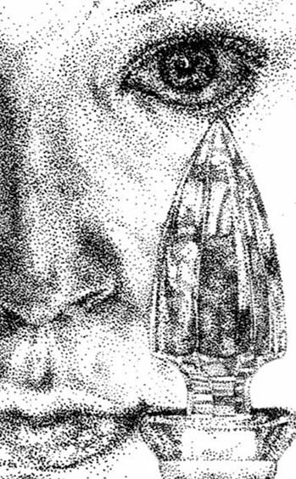
STIPPLING EXAMPLES

Slide 14
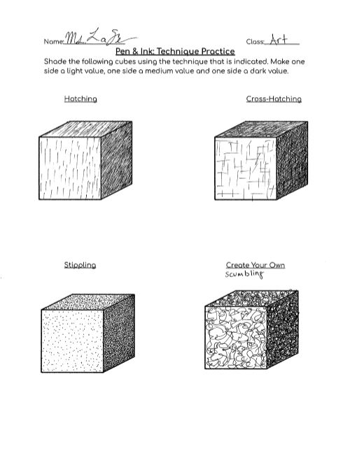
TODAY
Complete the PEN & INK Practice worksheet
Use hatching, cross-hatching, and stippling to create value study
Cube should have 1 light, 1 medium and 1 dark value

Slide 15
IMPORTANT!
  Once you have put ink to surface it is almost impossible to remove it.
  If your work is for reproduction purposes, you could use White-Out to cover a small mistake, but you have to make sure it is completely dry before you try inking over it again or it could clog your pen.
  Felt pen ink may turn bluish on top of White-Out.
  If the work will be displayed, this is not an option. You will have to start your work over or work the mistake in to your design.

