Slide 1
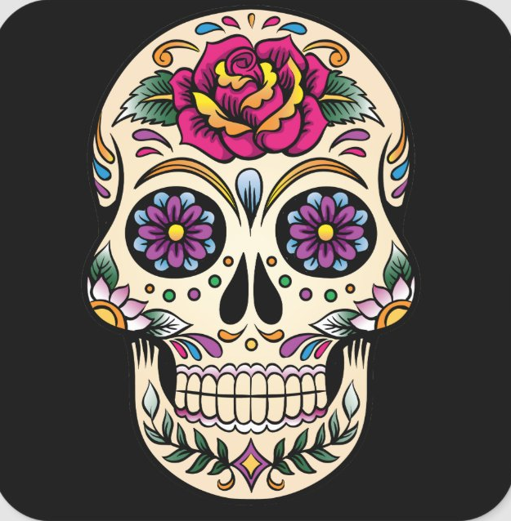
Dia De Los Muertos:
Sugar Skulls

Slide 2
What is Dia De Los Muertos?

Slide 3
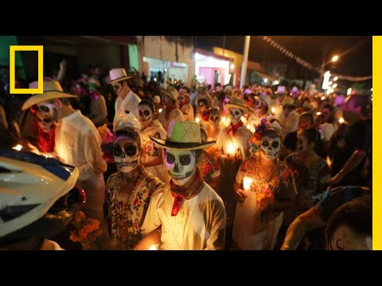
Let’s watch!

Slide 4
How is Dia De Los Muertos similar to Halloween in America?
  Nov. 1-2nd
How is it different?
How does our culture remember the dead?

Slide 5
Sugar Skulls
Dia De Los Muertos tradition

Slide 6
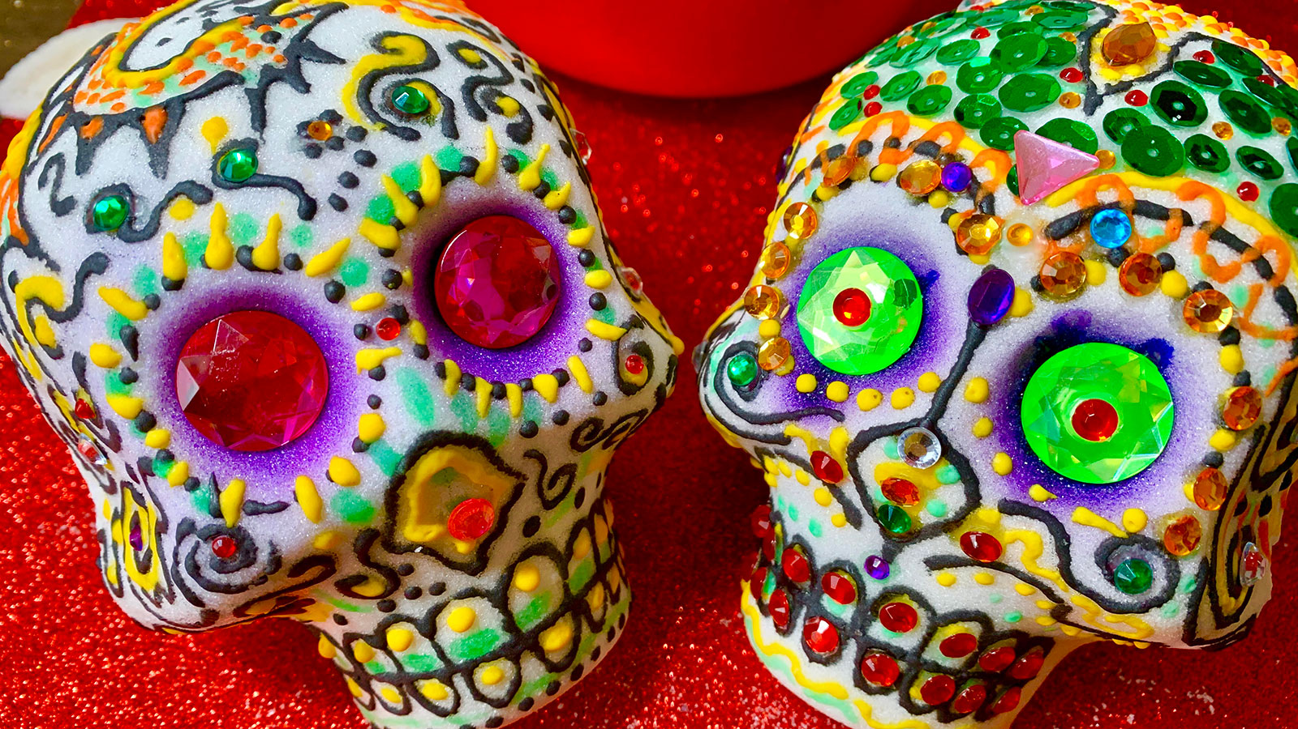
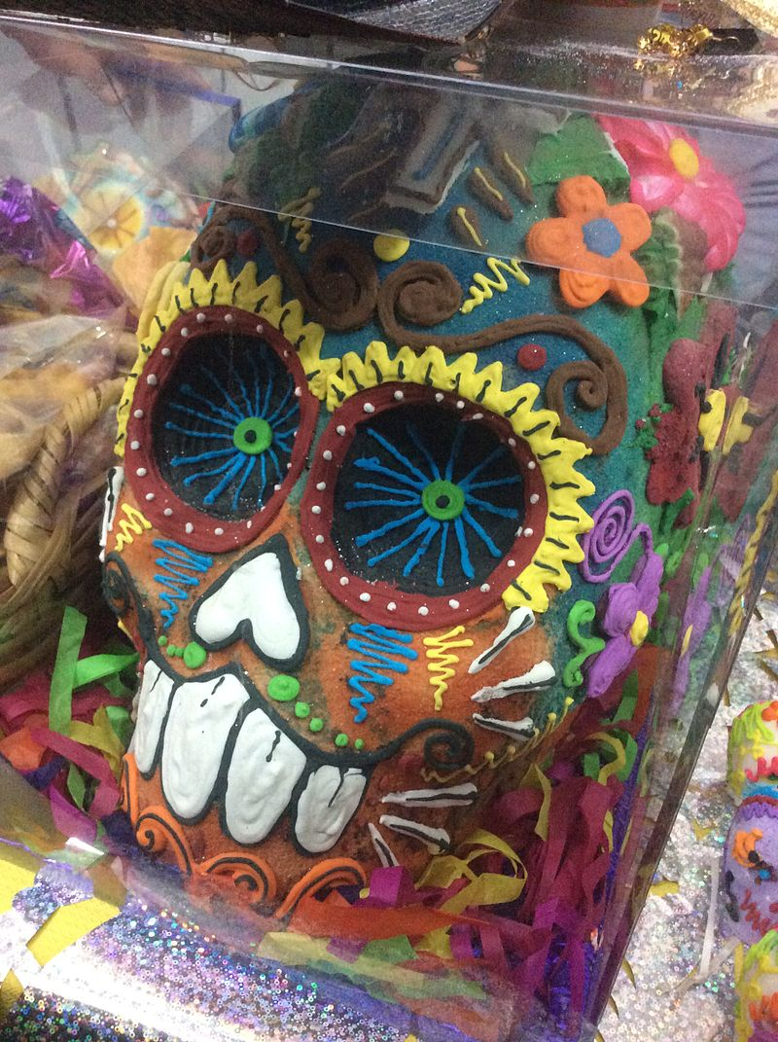
Edible or decorative skulls made (usually by hand) from either Alfeñiques (sugar) or clay and decorated with items such as colored foil, icing, beads, and feathers.
Any artistic representations of skulls
The skulls are created either for children or as offerings to be placed on altars known as “ofrendas”
Not meant to be eaten

Slide 7
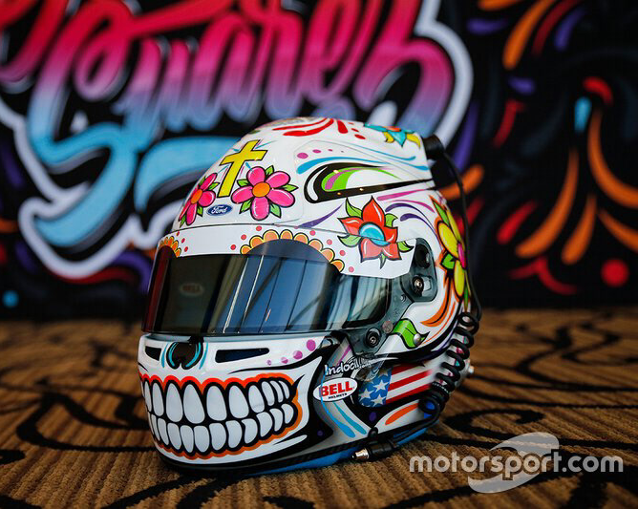
Race car helmet that Daniel Suarez wore

Slide 8
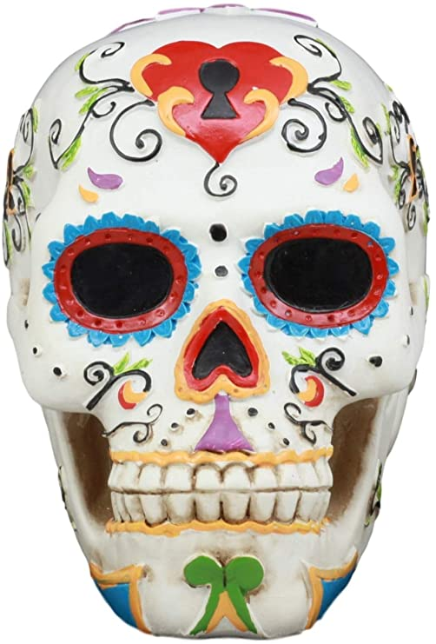
Symmetrical designs
Symbols can represent deceased relative

Slide 9
If you owe me your collage...
FIRST, use the block to finish your collage
Then….

Slide 10
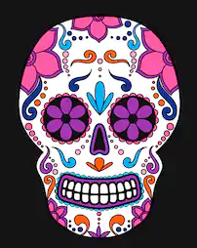
Make Your Own!
Decorate your own sugar skull!
You will need colored pencils, pencil and an eraser
Tip: Line design patterns!!
You keep it when finished
Have fun!

Slide 11
Next Class
Short week: you will likely need to attend zoom
Bring your supply baggy!
Begin next project

