Slide 1
Mandalas: Colors of the Universe
With Ms. Fiedler & Ms. La Fevre

Slide 2
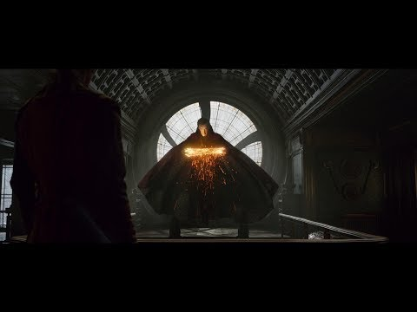
https://www.youtube.com/watch?v=7GR-9mxLzcs&t=442s

Slide 3
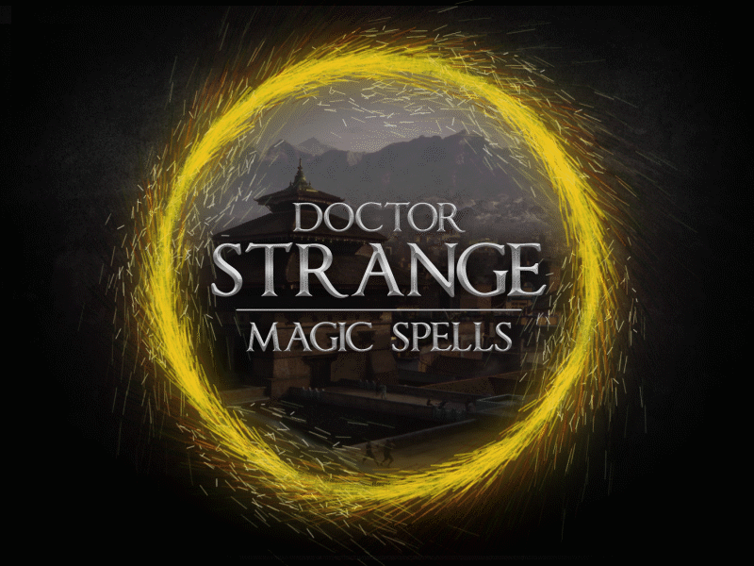
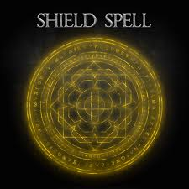
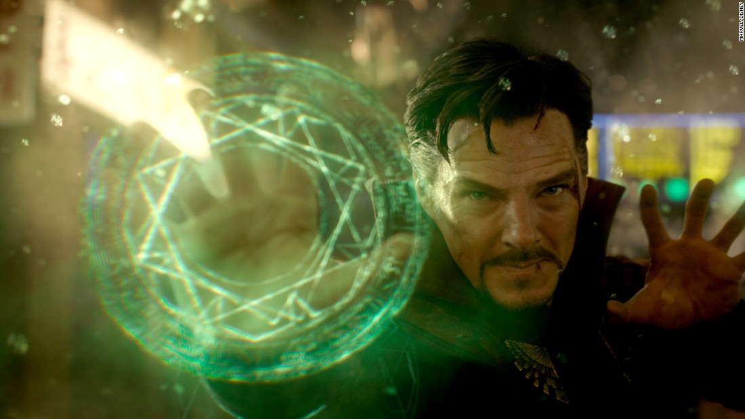

Slide 4
What do you think...
What is a mandala?
What do you think it is used for?
Whos creates and uses mandalas?

Slide 5
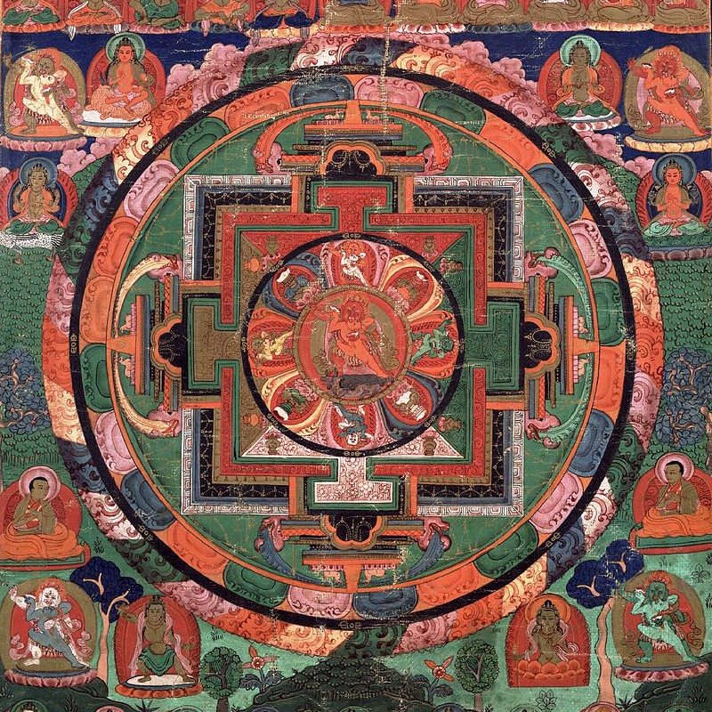
Mandalas
Mandalas are…
A spiritual/ritual symbol in the Indian religions of Hinduism and Buddhism
Represents the universe/cosmos
Design: can be a square with “4 gates" or circular with a central point. It uses radial symmetry.
Radial Symmetry: the condition of having similar parts regularly arranged around a central axis
Five Deity Mandala (17th cent.)
Buddhism

Slide 6
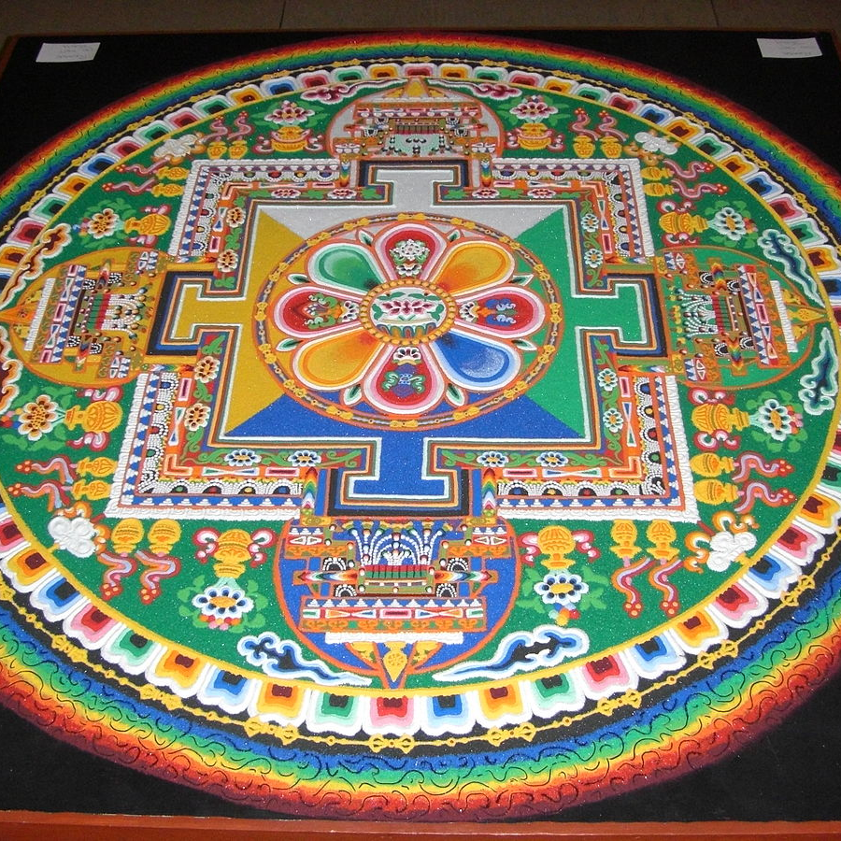
Types of Mandalas
Teaching: designed using symbolic shapes, lines, and colors to represent different aspects of philosophical/religious systems. Students create their Mandala to represent the things they have learned.
Healing Mandala: Made for the purpose of meditation. Used to deliver wisdom, evoke feelings of calm, and to channel focus/concentration.
Sand: Used traditionally by Buddhists and Navajo cultures. The designs are created using colored sands. They are intricate and use symbols to “represent the importance of human life".

Slide 7
Common Symbolism
Wheel with eight spokes: Circle - representation of a perfect universe. Eight spokes represents the “Eightfold Path of Buddhism, a summary of practices that lead to liberation and rebirth.”
Bells: Represents openness and emptying of the mind allowing entrance of wisdom/clarity.
Triangle: Facing upward, represents action/energy. Facing downward, represents creativity/pursuit of knowledge.
Lotus flower: “A sacred symbol in Buddhism, the symmetry of a lotus depicts balance. As a lotus reaches up from underwater into the light, so too does a human reaching for spiritual awakening and enlightenment.”
Sun: Commonly used, can represent the universe, “often carrying meanings related to life and energy.”

Slide 8
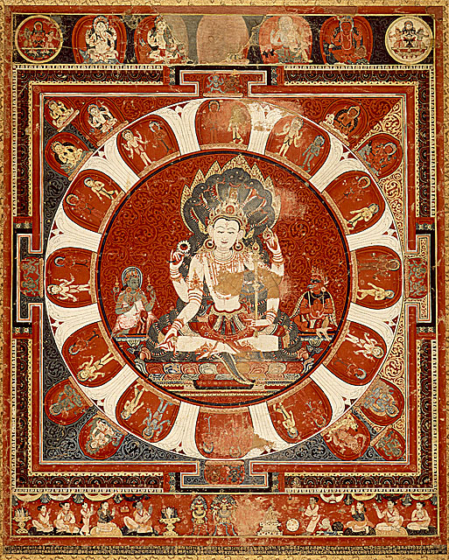
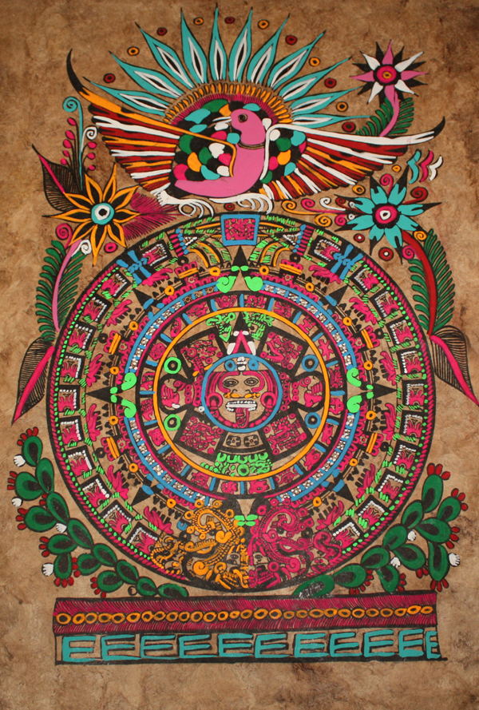
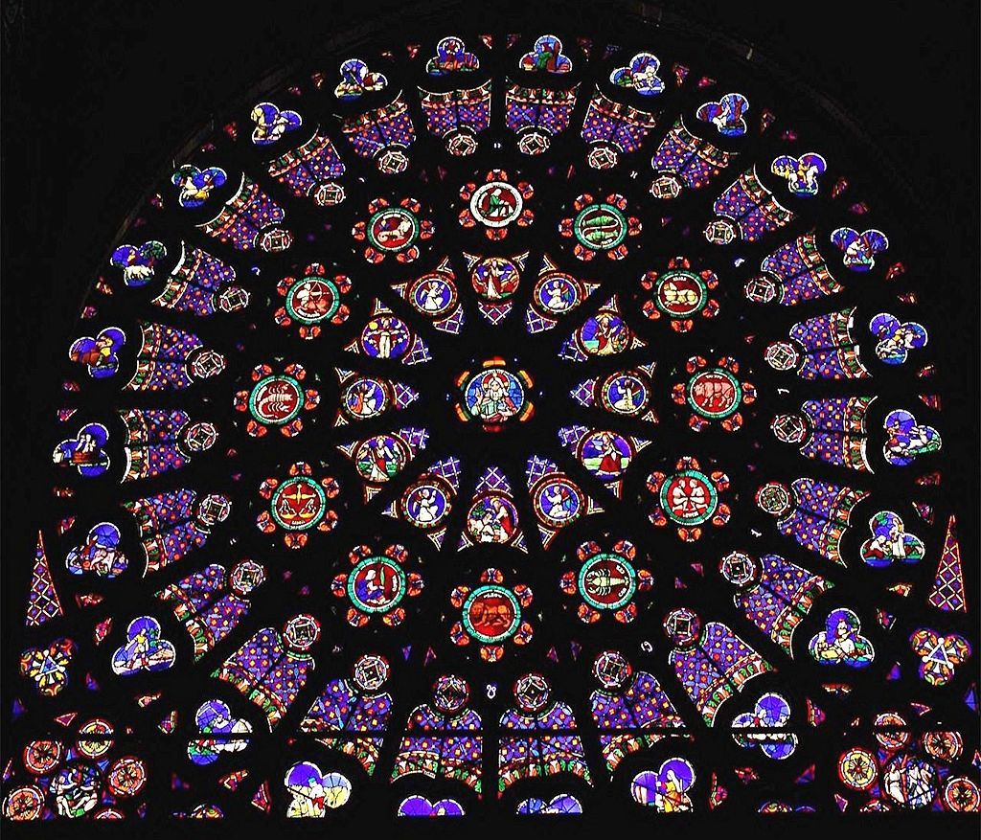
Historical Mandalas
Mandala of Vishnu (1420)
Hinduism
Aztec Sun Stone (print)
Mesoamerica
the north rose of the Abbey of St Denis, Paris
Christianity
Notes:
Vishnu, the second trinity god in hinduism, the preserver of life. Mandala created to call upon Vishnu
Sun stone about the main city being the center of the universe
the north rose of the Abbey of St Denis, Paris, showing God the Creator, surrounded by the Days of Creation, the Order of the Heavens represented by the Zodiac and the Order of Earth as represented by the Labours of the Months. In the corners are the Fall of Mankind.

Slide 9
We will be creating mandalas that are a combination of “healing” mandalas and “sand" mandalas.
We will be creating them using gouache.
Our mandalas will be centered around...

Slide 10
Empathy and Identity
Our mandalas will focus on human empathy (world issues) and/or personal identity
They will also study color

Slide 11
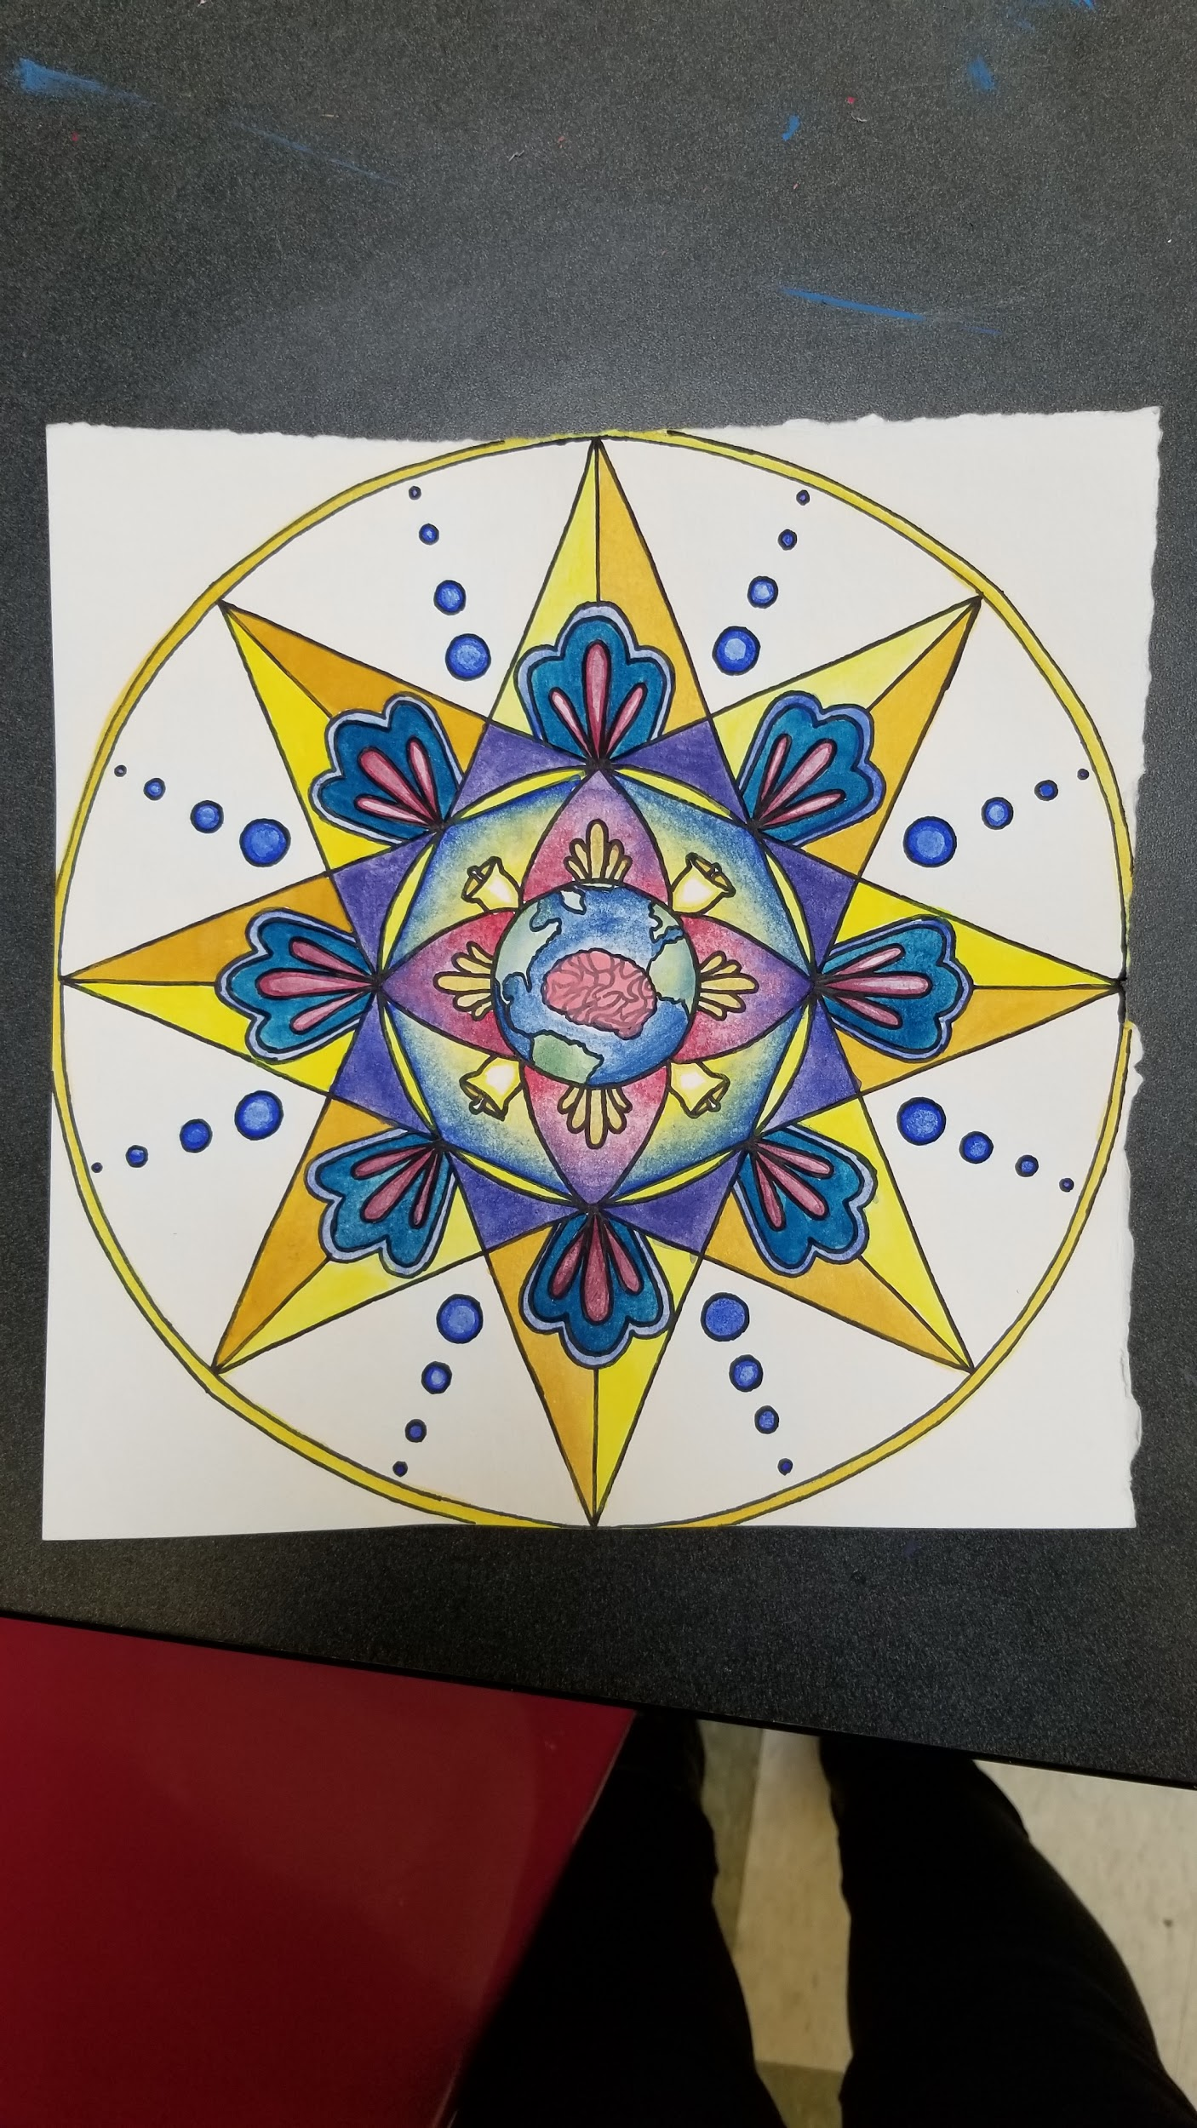
Our Example:

Slide 12

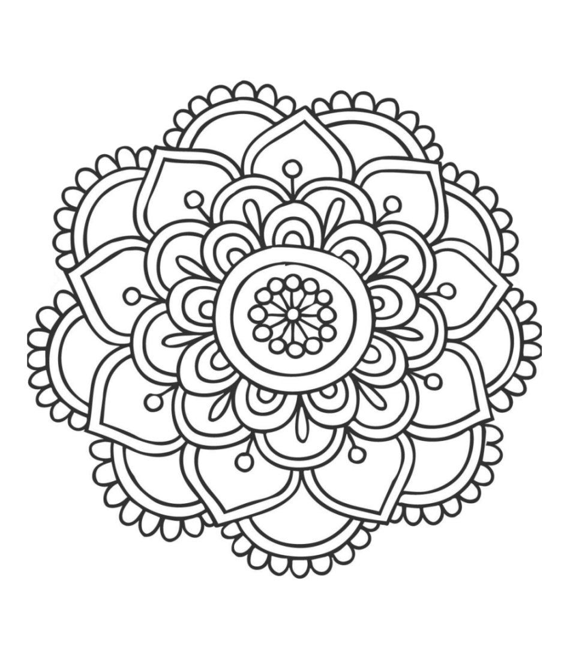
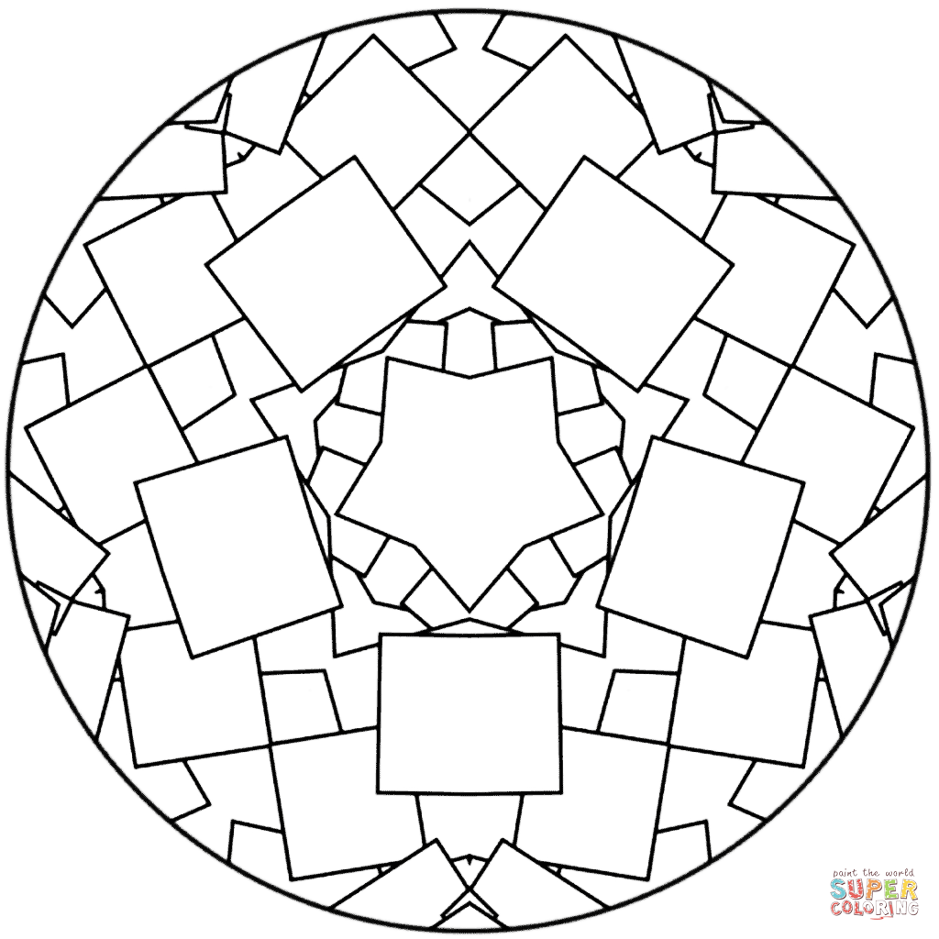
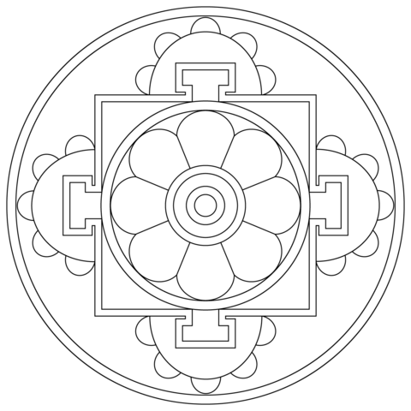
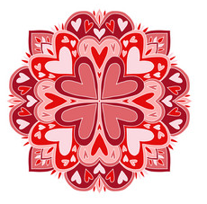
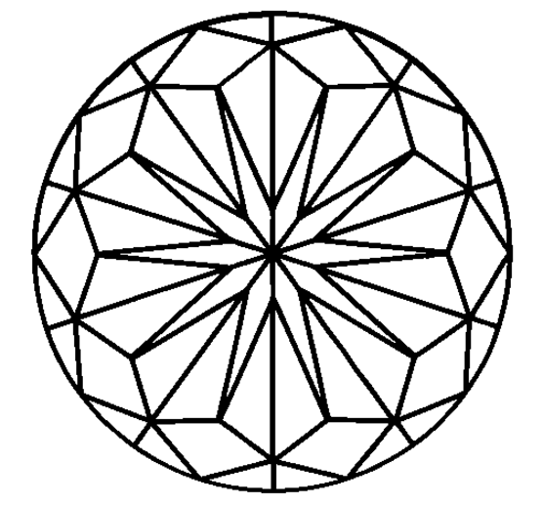

Slide 13
Today’s Agenda...
Demonstration on radial symmetry and first steps to creating your mandala
Color Theory Worksheet
Research and brainstorming/sketching ideas

Slide 14
Today’s Goals
By the end of class
Finish the color theory worksheet
Select and idea/concept - think about how you will convey this (symbols, colors, patterns, etc.)
Create sketches or a draft of your mandala
Try to get your “final” drawing done
For Homework:
Select an idea/concept
Have sketches or draft completed (in sketchbook)
Try to begin your final drawing

Slide 15
Day 2: Mandalas

Slide 16
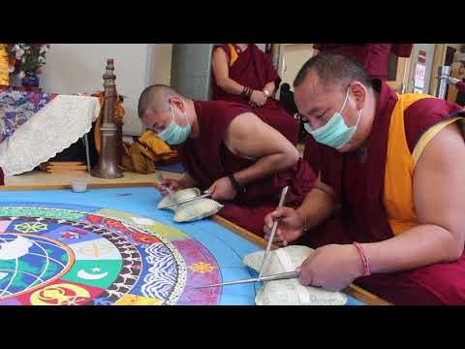
https://www.youtube.com/watch?v=G58Pujijsqc

Slide 17
Today’s Goals
By the end of class
Select and idea/concept - think about how you will convey this (symbols, colors, patterns, etc.)
Create sketches or a draft of your mandala
Start final drawing
For Homework:
Work on final drawing if not completed, begin outlining in sharpie.

Slide 18
Day 3

Slide 19
Today’s Goals
By the end of class
Work on drawing your mandala
Outline in sharpie
Answer exit slip question
For Homework:
Work on final drawing if not completed, begin outlining in sharpie.
Answer Google Classroom questions about Gouache!

Slide 20
Day 4

Slide 21
Discussion
What is empathy? Identity?
How do we express empathy and identity?
Why is it important to address world issues?
Why is it important for us to express our feelings through art?
How does identity play a role in our lives?

Slide 22
Today’s Goals
By the end of class
Work on drawing your mandala
Outline in sharpie
Begin Painting
For Homework:
Work on final drawing if not completed, begin outlining in sharpie.
Answer Google Classroom questions about Gouache!

Slide 23
Day 5

Slide 24
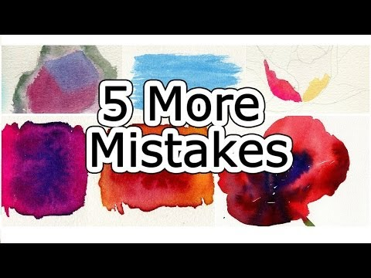
Painting Mistakes
Errores de pintura
https://youtu.be/LIGOeWG_fSE

Slide 25
Day 6

Slide 26
For today...
Finish up your mandala, try to get it as done as possible. Don’t forget to put your name on the back of your mandala!
You guys get an extra day :)

Slide 27
Mini Critique: Post-It Notes
On your post-it note, please discuss the following aspects of your peer’s mandala:
Does the mandala successfully convey the concept? How (think about the colors, symbols and patterns)?
What do you like about their mandala?
What do you think needs to be improved or what do you think would make it more successful?

Slide 28
Citations
https://en.wikipedia.org/wiki/Rose_window#/media/File:St_Denis_North_a.jpg Christian mandala
https://en.wikipedia.org/wiki/Mandala Historical Mandalas
https://www.youtube.com/watch?v=G58Pujijsqc mandala video
https://www.youtube.com/watch?v=7GR-9mxLzcs&t=442s Doctor Strange Video
https://www.merriam-webster.com/dictionary/radial%20symmetry radial symmetry definition
https://youtu.be/LIGOeWG_fSE Color mistakes video

