Slide 1
Mythological Relief Sculptures
Ms. LaFevre

Slide 2
1.
Review
Relief Sculpture

Slide 3
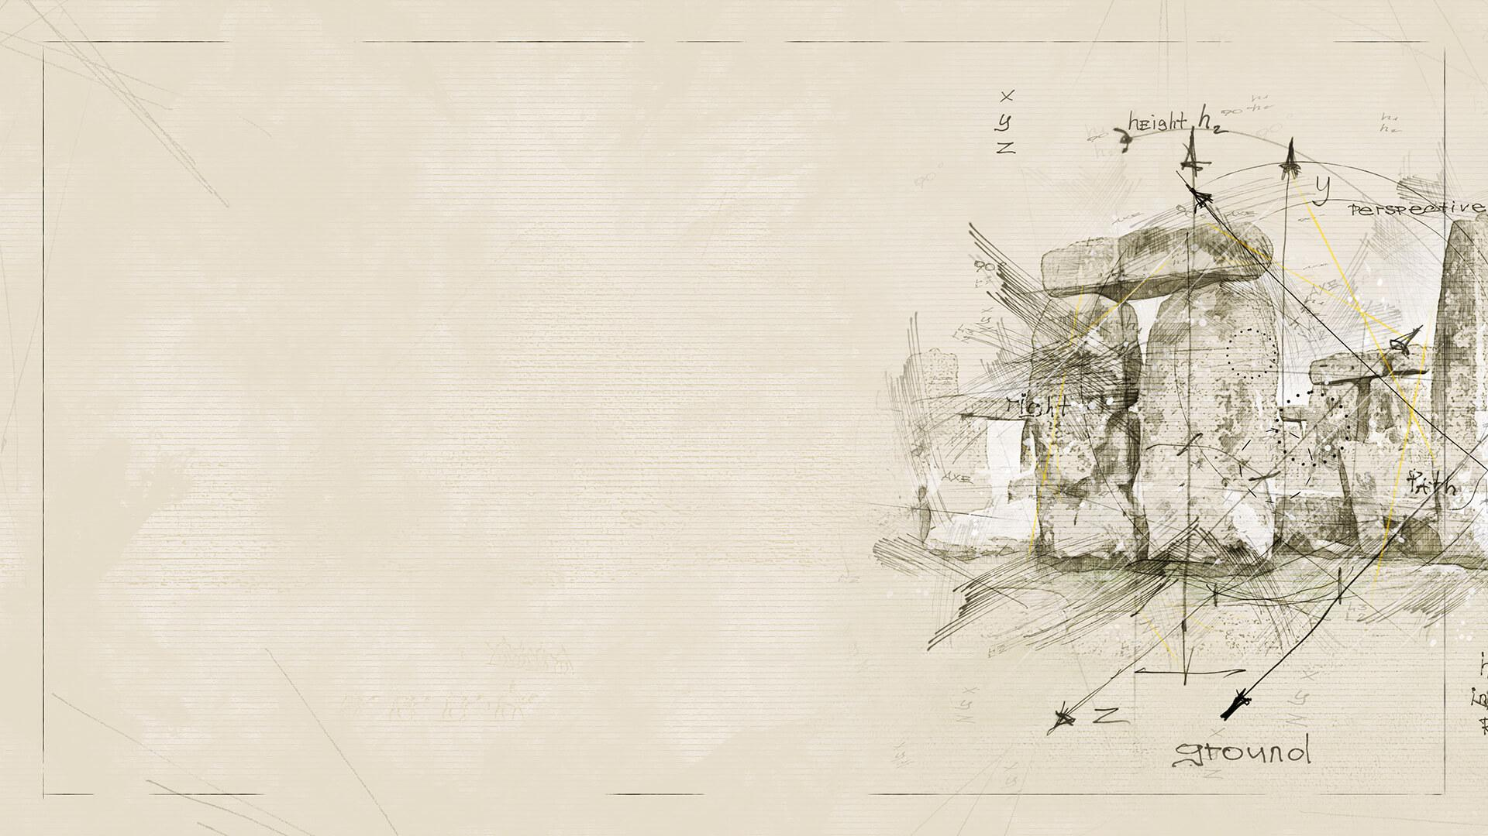
What is a relief Sculpture?

Slide 4
What is a relief Sculpture?
Relief is a sculptural technique where the sculpted elements remain attached to a solid background of the same material.
“Subtractive” techniques: carving, impressing, scraping, incising
Materials: Clay, plaster, marble/stone, metals
How is a relief sculpture different from a sculpture-in-the-round?

Slide 5
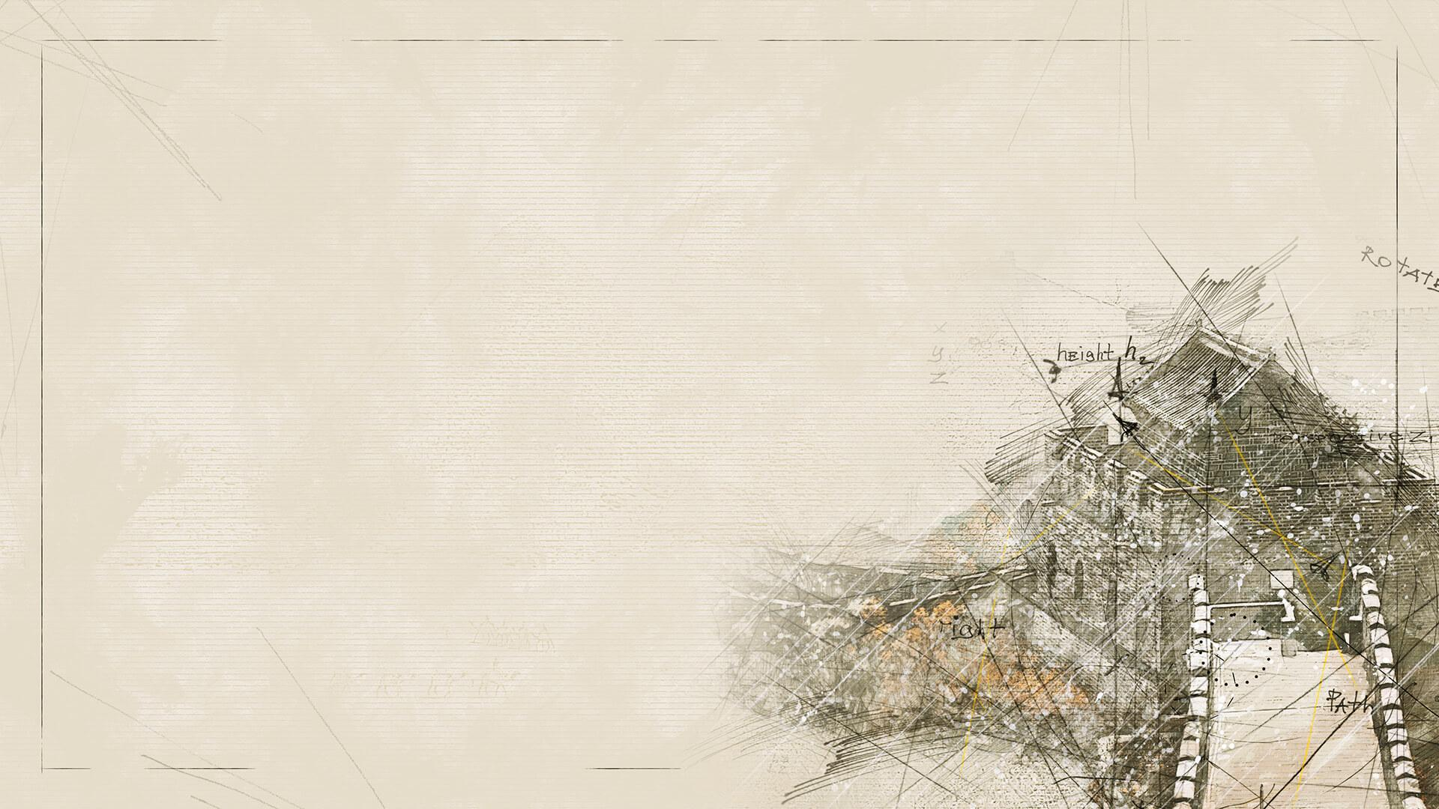
Types of relief
Low Relief (bas-relief)
Middle Relief (mezzo-relief)
High Relief (alto-relief)
Sunken Relief (incised, coelanaglyphic or intaglio relief), mostly Egyptian art

Slide 6
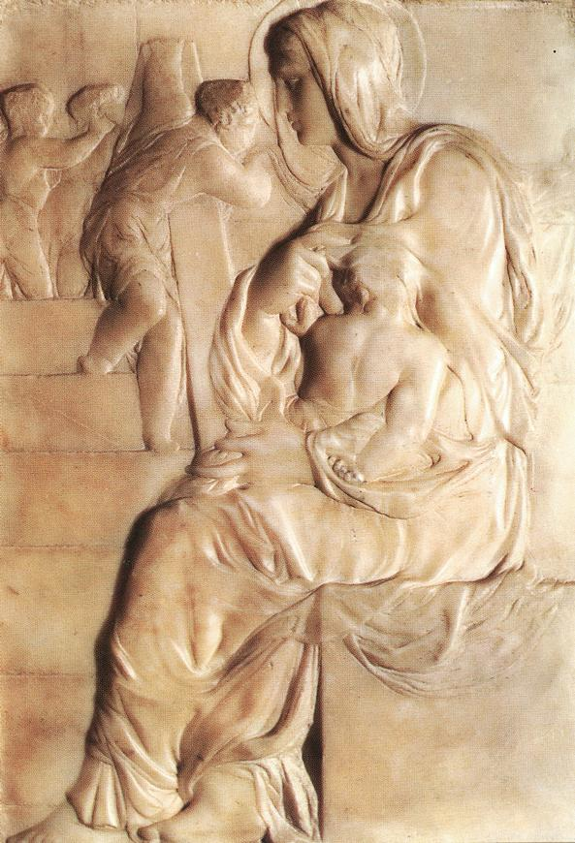
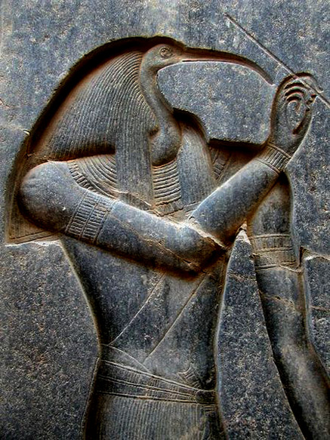
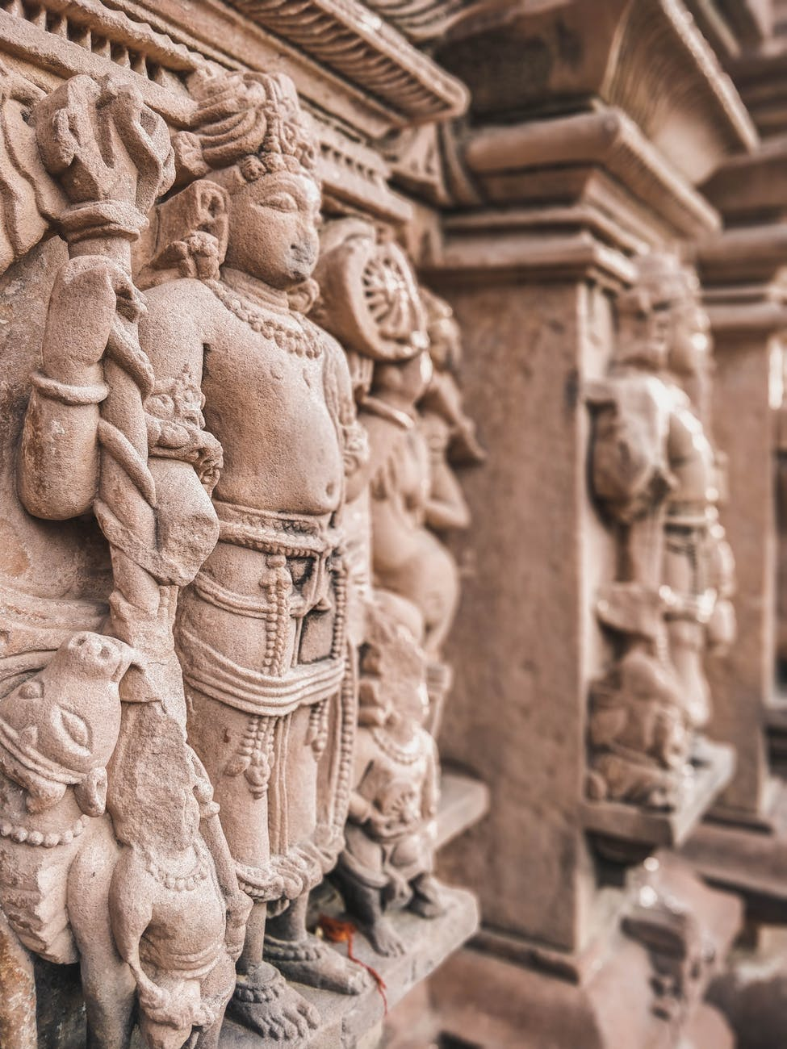
Sunken Relief
Low Relief
High Relief

Slide 7
2.
Lets Play a game!
Yes… you will have to get up for this

Slide 8
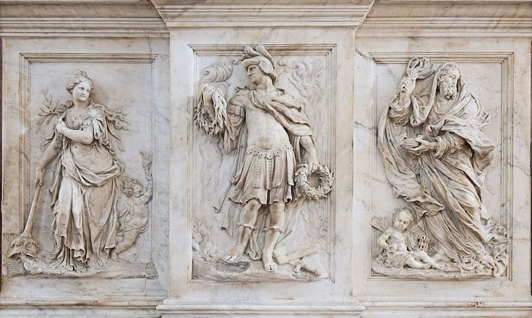
Interior of Santi Giovanni e Paolo in Venice. “Monument of the Valier.” (Photo: WikimediaCommons (CC BY-SA 4.0))

Slide 9
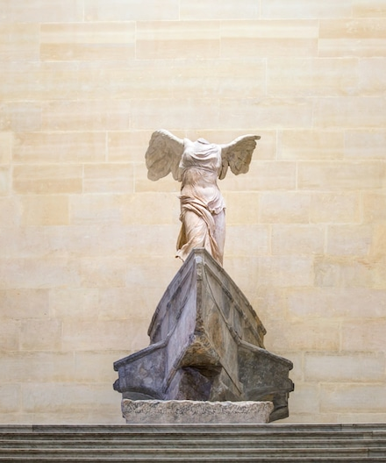
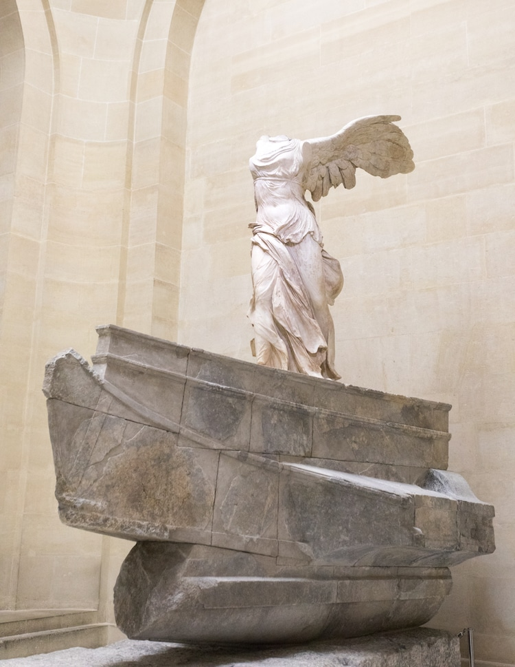
The Winged Victory of Samothrace (Photo: muratart’ via Shutterstock)

Slide 10
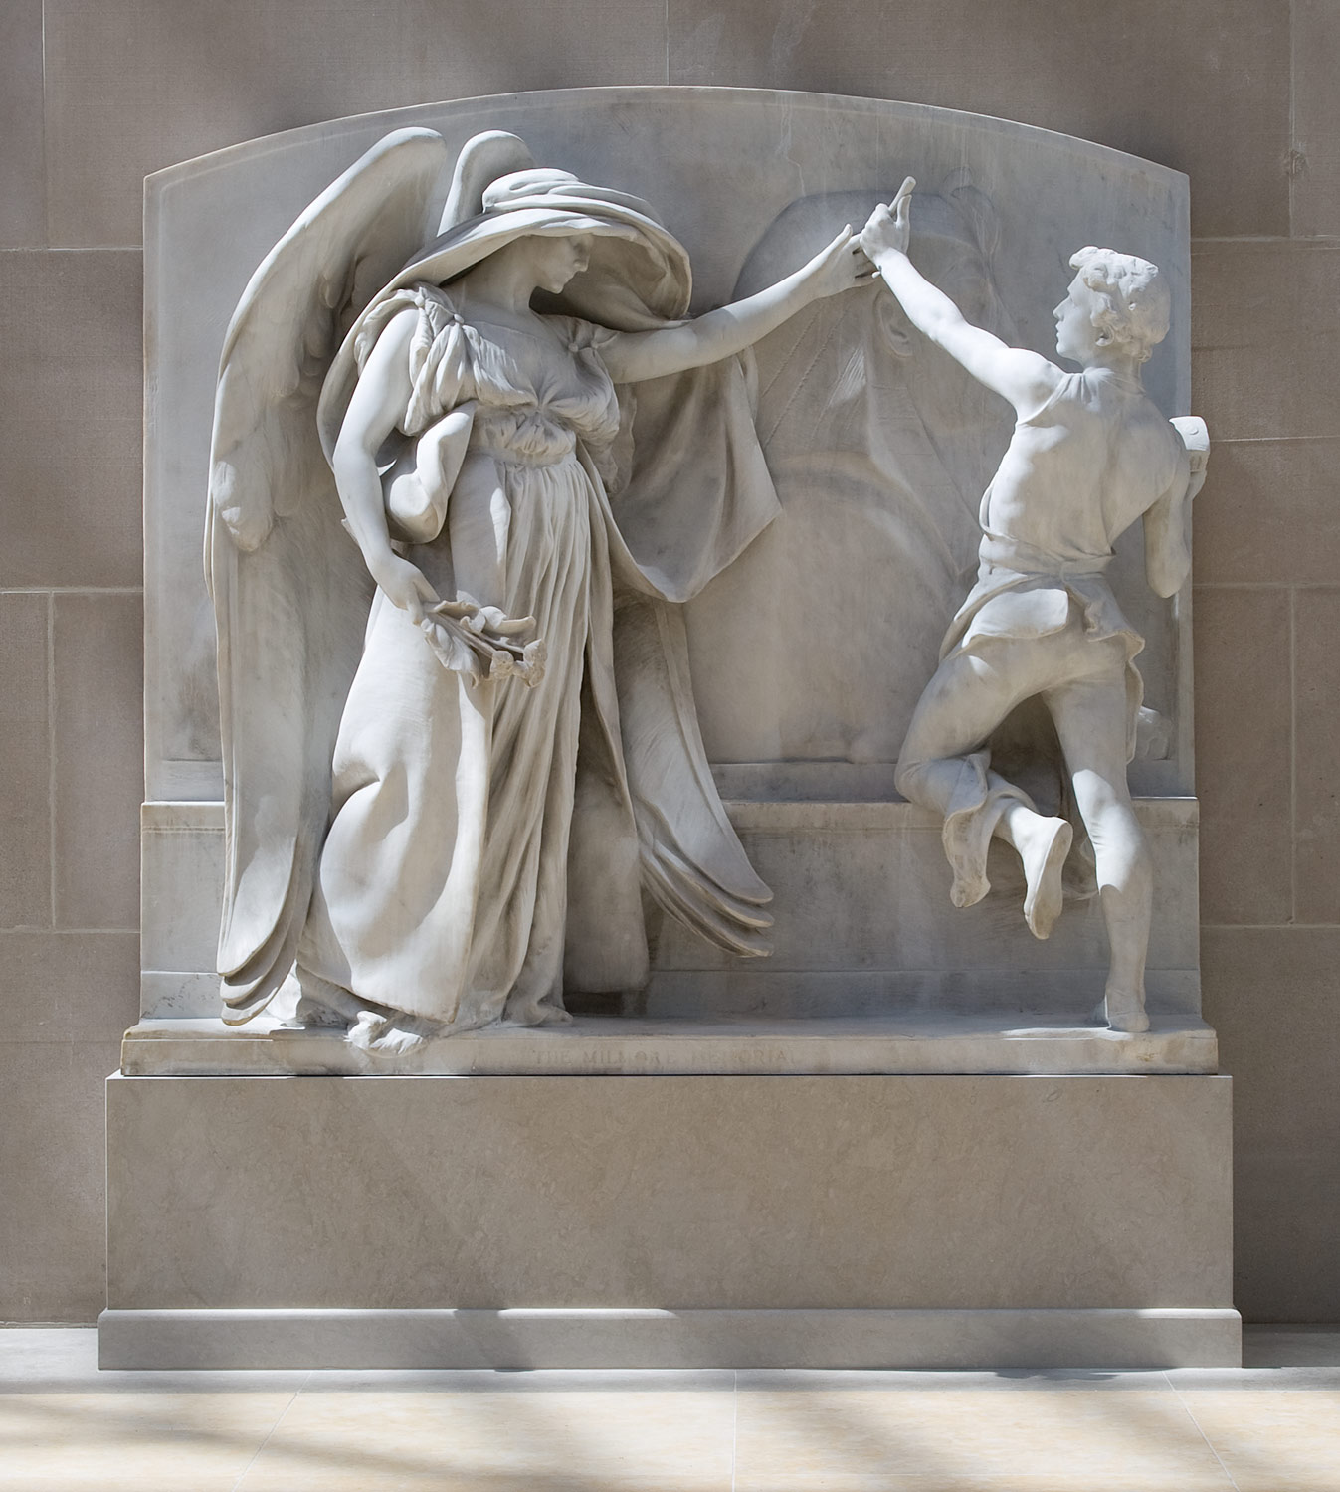
“The Angel of Death”, from the Milmore Memorial by Daniel Chester French

Slide 11
What do these 3 pieces have in common?
Think about…
Where they are displayed
Why they would be made
Who looks at them

Slide 12
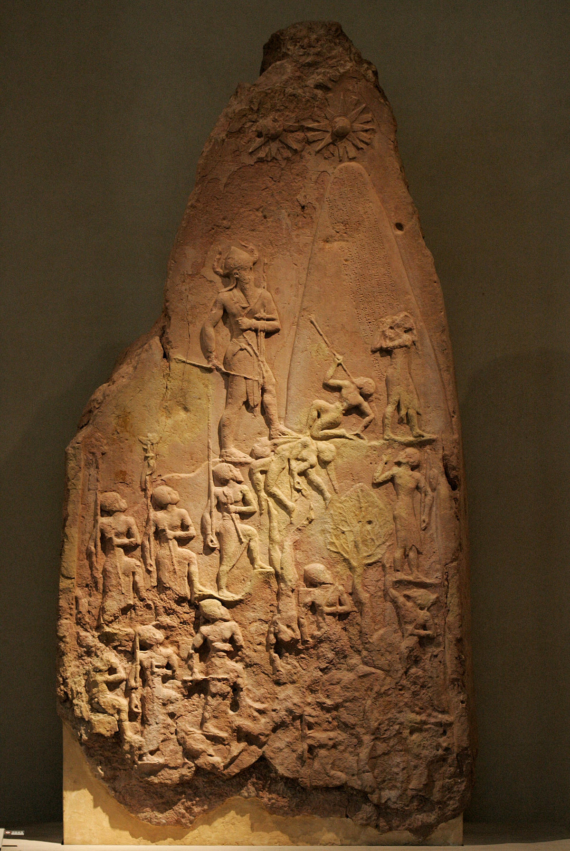
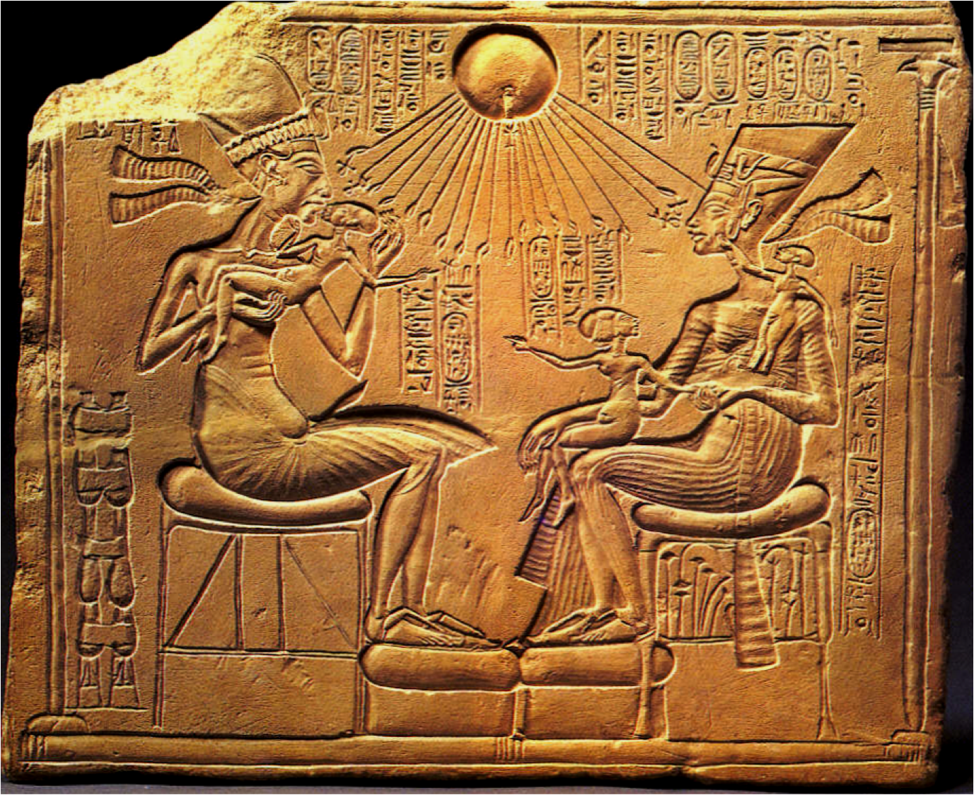
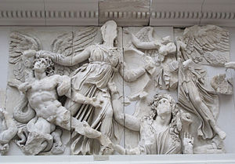
Athena and Nike fight Alkyoneus
From the Pergamon Altar
Victory Stele of Naram Sin
Sunken Relief of Pharaoh Akhenaten and Nefertiti

Slide 13
Close-up

Slide 14
Their purpose: relief Sculpture
They are made to educate the masses!
How does this relate to contemporary life (modern day)?

Slide 15
3.
Mythology and Relief Sculpture
What is mythology and how has relief sculpture been used to tell stories

Slide 16
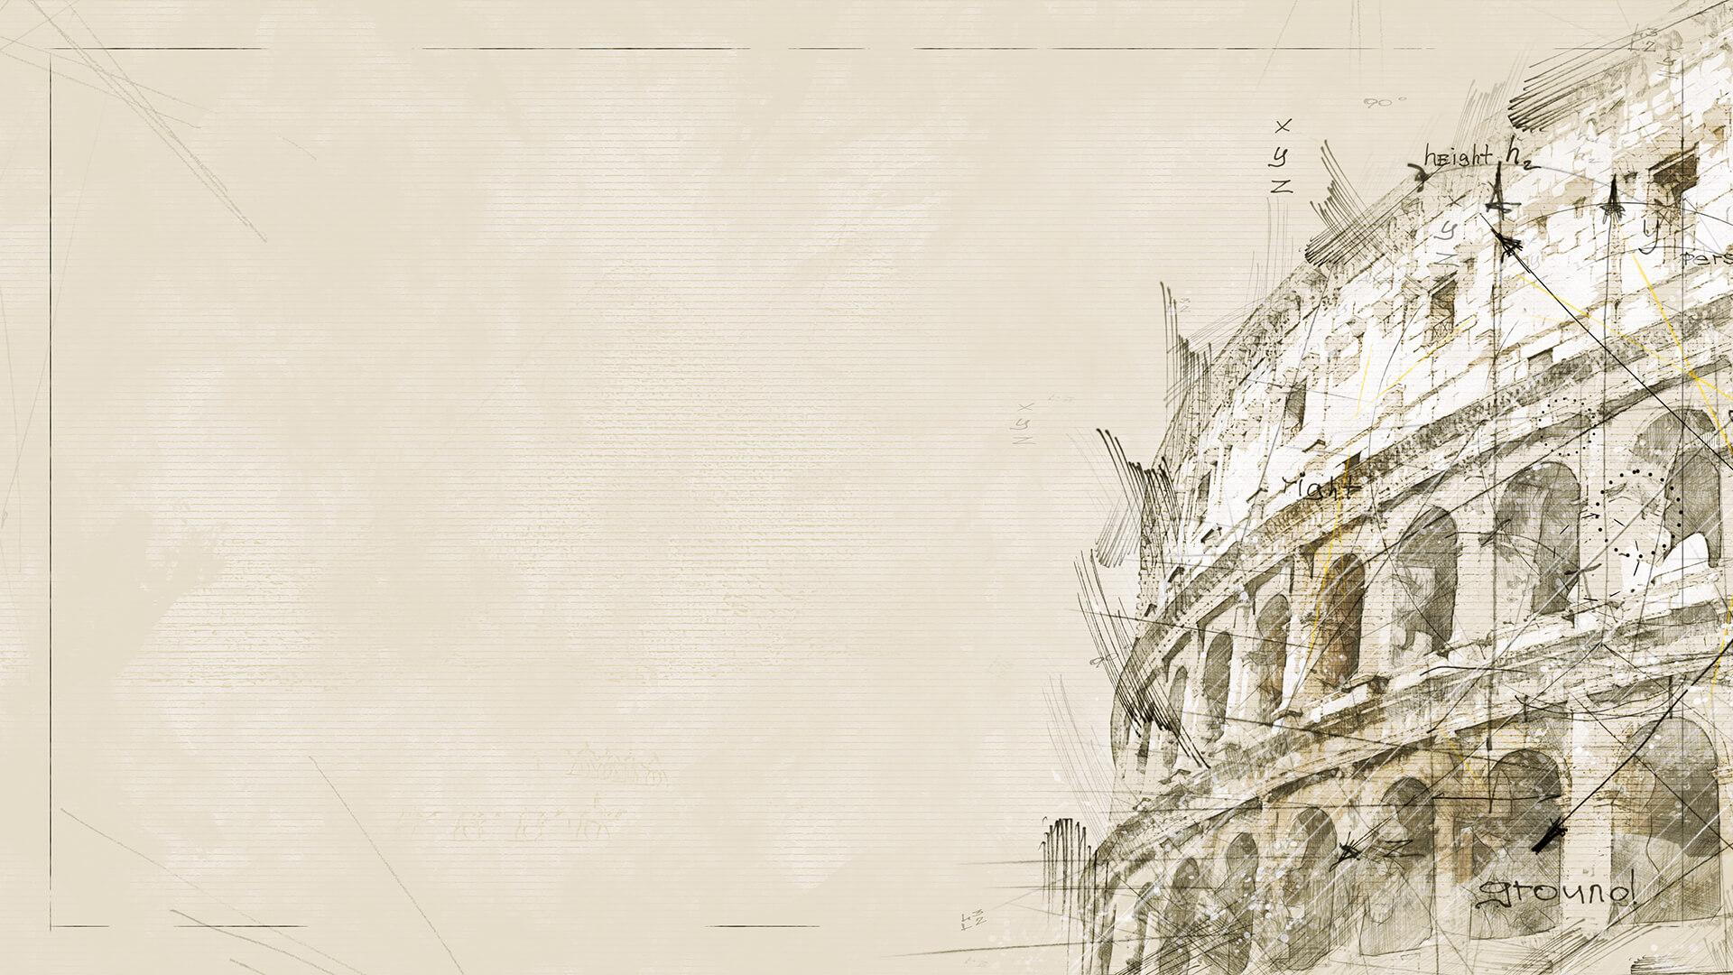
What Are myths?
What is mythology??
Name a couple!

Slide 17
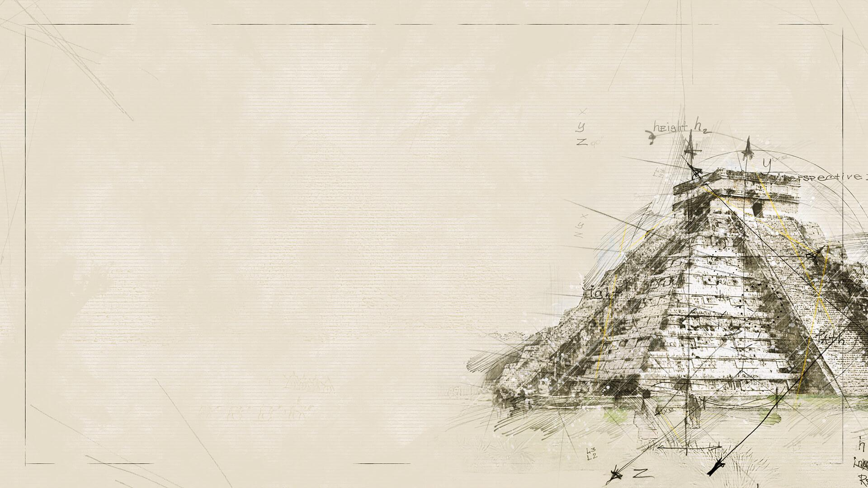
What is Mythology/Myths?
Mythology (from the Greek mythos for story-of-the-people, and logos for word or speech, so the spoken story of a people) is the study and interpretation of often sacred tales or fables of a culture known as myths or the collection of such stories which deal with various aspects of the human condition: good and evil; the meaning of suffering; human origins; the origin of place-names, animals, cultural values, and traditions; the meaning of life and death; the afterlife; and the gods or a god.
Myths express the beliefs and values about these subjects held by a certain culture.

Slide 18
Purpose of Mythology/Myths?
MYTH IS A NECESSARY ASPECT OF THE HUMAN PSYCHE WHICH NEEDS TO FIND MEANING & ORDER IN THE WORLD.”
- Carl Jung

Slide 19
Purpose of Mythology/Myths?
Myths helped people make sense of the world
  Weather phenomena
  Creation of man
  Illness
  War
  Life lessons

Slide 20
Relation Between myths and relief sculpture
Athena and Nike fight Alkyoneus
From the Pergamon Altar
Victory Stele of Naram Sin
Sunken Relief of Pharaoh Akhenaten and Nefertiti

Slide 21
3.
Our project
Creating your mythological relief sculpture

Slide 22
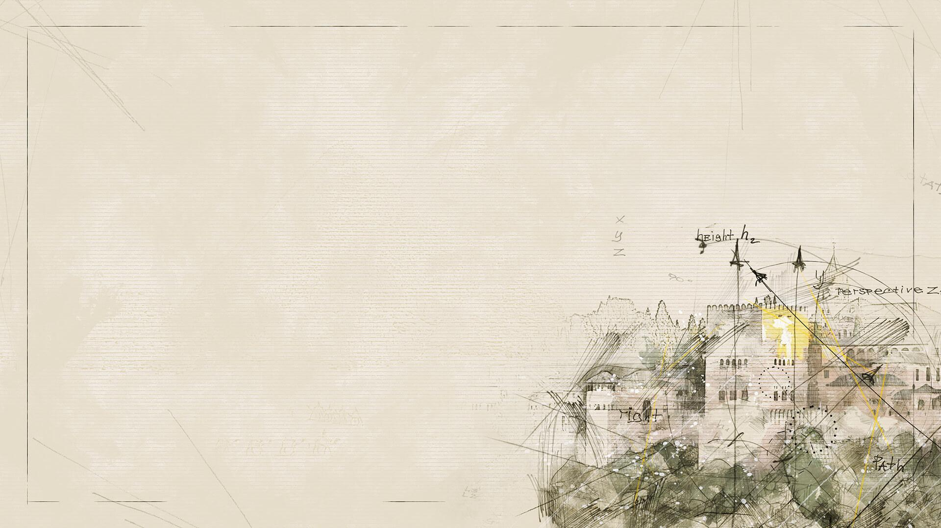
We will….
Create your own Mythological Relief Sculpture!
Guidelines
Based off of a myth of your choice!
  (Not just Roman/Greek Myths)
Material: clay (roughly 10”x10”)
Type of relief sculpture
3-5 levels of depth
Give emphasis to the main character
Be creative!

Slide 23
For Today….
Look up different myths that interest you, select one
  Think about what the purpose or meaning of the story is. What can be learned?
Begin drawing thumbnail sketches (3)
  Look up images for inspiration
  Print them out if you will be using them for your final sketch

Slide 24
Critique questions
Artist:
What myth did you choose? Explain its story.
Why did you choose this myth?
How did you portray this myth?
What did you do well? What do you think you can improve on?
Viewers: What do you like/what did the artist do well?
What do you think they could change/improve? Why?
Final comments and questions.

Slide 25
Citations
Wikipedia.com
http://www.visual-arts-cork.com/sculpture/relief.htm
https://www.ancient.eu/mythology/
https://www.pinterest.com/pin/691302611524185523/
https://en.wikipedia.org/wiki/Pergamon_Altar

